Slide 1



QuarantinART
Inspire adults to explore their artistic side
KA227-5C93146E
KA2 - Cooperation for innovation and exchange of good practice KA227 – Partnerships for the Creative World
Module: CUT, SEW AND EMBROIDER
Topic: 1,2,3,4
Developed from: Cooperativa Sociale Rinascita

Slide 2
INDEX
Objectives of the module
General description
1.1 History
2. Different types of fabrics
2.1 Biological Fabrics
2.2 Ecological fabrics
2.3 Fabrics of animal origin
2.4 Artificial and synthetic fabrics
2.5 Recyclable fabrics
2.6 Quiz
2.7 Answers

Slide 3
INDEX
How to set up a sewing room
Repairing / Mending / Patching
4.1 How to replace a Zip
4.2 Sewing up a tear manually
4.3 How to stitch a patch
4.4 How to sew on a button
4.5 Summary
4.6 Quiz
4.7 Answers
4.8 References
4.9 Badge

Slide 4
INDEX
Modifying a garment
5.1 Shrinking new clothes by washing them
5.2 Shrinking a trouser manually
5.3 How to widen a trouser
5.4 Summary
5.5 Quiz
5.6 Answers
5.7 References
5.8 Badge
Decorating fabrics
6.1 Making a fabric flower

Slide 5
INDEX
6.2. How to sew sequins onto fabrics
6.3 Summary
6.4 Quiz
6.5 Answers
6.6 References
6.7 Badge
7. How to breathe a new life into clothing and accessories
7.1 Recycling clothes and the environment
7.2 The lifecycle of clothes
7.3 Reuse and customize: A guide to second hand clothes
7.4 Laboratory: how to create a handbag from recycled jeans

Slide 6
INDEX
7.5 Summary
7.6 Quiz
7.7 Answers
7.8 References
7.9 Badge

Slide 7
OBJECTIVES OF THE MODULE:
Make sure that women develop practical skills in the art of cutting/sewing/embroidery.
Increase the employability and opportunities of women with few skills through cutting and sewing.

Slide 8
GENERAL DESCRIPTION OF THE MODULE
In this module we will illustrate you the complex art of Tailoring. This training is focused on low-skilled women, to give them the knowledge of the principles of sewing and the possibility to find an employment by themselves. This module will be introducing the basic practices of sewing and will teach the necessary skills to work in your own. This art is made up of different phases, from cutting, to sewing and then ending with embroidery and we will go through each phase step by step.
Expected impact of the course in terms of developing the above training objectives.
The target group of this training are low-skilled women and this is an opportunity to overcome the challenges of quarantine. They could practice and learn from it in order to make it as a job or an hobby. They could develop more abilities, more awareness and become more self-confident. One of the main objectives of the training is to promote women employment and increase their opportunities.

Slide 9
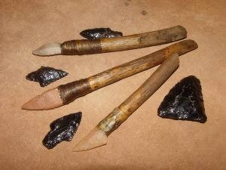
1.1. HISTORY
Sewing is not a recent invention, but has its roots in the mists of time, when primitive men felt the need to cover themselves and to protect themselves from the cold.
In fact, prehistoric man did not simply cover himself by wrapping the animal skin around their body but they already used the techniques of cutting and sewing that have been handed down to the present day, and sophisticated them to simplify his work.
Being very ingenious, the primitives were able to make tools suitable for their purposes, found in many archaeological excavations. These were either very sharp flints that they used for fleshing, cutting and scraping skins, or bone awls, the ancestors of our needles, with which they pierced skins to thread lianas and tendons through them to hold different parts together, anticipating the current use of thread. The invention of scissors, used instead of flints, dates back to the Second Iron Age, for example.

Slide 10
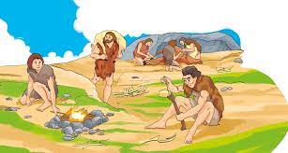
Towards the end of the Pleistocene, humans learn to process the skins of animals killed in hunting and begin to use them to shelter from the cold of the incipient ice ages.
The process is not simple, and to learn how to make decent clothes one has to go back some 40,000 years, when the first sewing needles, made from animal ivory, also appear.
Already the Neanderthals around 100,000 years ago were painting their bodies with ochre dyes and 'decorating' the dead with shells and animal remains before burial. But we also know that as early as 50,000 years ago, our ancestors collected shells and other 'useless' objects probably only for the pleasure of possessing them, perhaps to make some rudimentary jewellery out of them.
In the Palaeolithic period itself, with the birth of structured social groups, hierarchies were born, and new needs arose, including that of organising social life, performing rituals and defending oneself against enemies. Thus, the first elements of social characterisation through external representation make their appearance: dress and the mask.

Slide 11

Mesopotamian civilizations (Sumerians, Assyrians, Babylonians) gave a major impetus to the weaving and making of clothing, consisting of tunics (or cassocks). Apparently, the Sumerians "invented" sleeves, but the Sumerian tunic was later enriched by the Assyrians with a stole as well.
The clothes of ancient Greece, on the other hand, are mainly made of cuts of rectangular wool or linen cloth, fastened at the shoulders with decorated pins and belted with a sash. Women wore loose-fitting robes (peplos), men wore a cloak (chlamys). Both sexes then wore the chiton, a type of tunic reaching down to the knees for men and down to the feet for women. Dress began to be understood as a representation of refinement and elegance as well as social status.

Slide 12
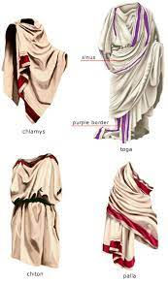
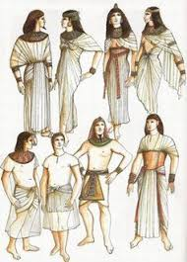
The basic garment for the early Romans was the trabea, a broad cloak made of a piece of cloth. The Romans wore a kind of undergarment (the indumenta), which for women also included a breast-band. Men wore one or more overlapping, foot-length tunics, and on top a toga, i.e. a cloak worn over the arm.
In all probability it was the Persians who made the first real dress, complete with tunic, trousers and belt. The eclecticism of the Persians was opposed by the rigid traditionalism of the Egyptians, who considered fabrics of animal origin to be impure and made clothes in light linen. The oldest embroideries that have come down to us come from Egypt in the 16th century, they are figures embroidered in thick brown thread on underwear, preserved thanks to the dry desert climate..

Slide 13
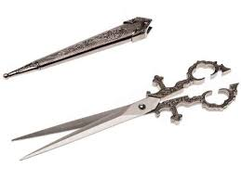
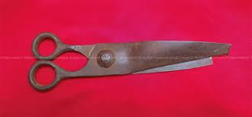
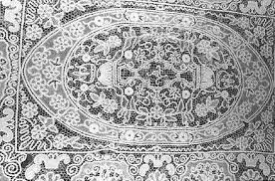
Around the year 1000, an Arab school of weaving and embroidery developed in Palermo, becoming famous for the production of the precious vestments used in coronation ceremonies.
In the Middle Ages, we find depictions of scissors in numerous bas-reliefs, important documents that tell of the prolific activity of tailors, worthy of being handed down to future societies.
The Renaissance, too, has left us plenty of evidence of this in bas-reliefs, but here we also admire a new aesthetic refinement, more or less marked, depending on their use. It was in this period, in fact, that embroidery began to become an art, as well as an activity, and was coveted by all maidens, whatever their social rank.

Slide 14
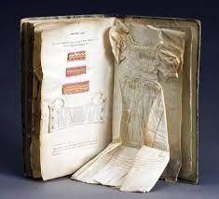
The 15th and 16th centuries During the Renaissance, Italian embroidery reached its peak: the most active centres were Venice and Genoa. Designs for embroidery were even provided by artists such as Leonardo and Raphael.
From the mid-16th century, liturgical robes began to bear embroidery with profane ornamental motifs, along with traditional religious ones, lace motifs appeared.
The 17th and 18th centuries saw the appearance of the first embroidery books, from which to copy stitches and decorative designs

Slide 15
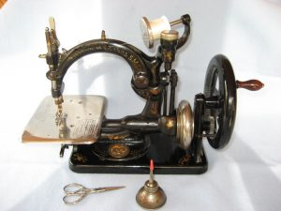
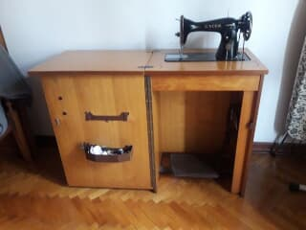
In the 19th century, the guilds of tailors, merchants, drapers, began to use the image of scissors as a symbol of their activity, used in their coats of arms and statutes.
And it was in 1830 that a prototype sewing machine was invented, invented by the Frenchman Thimonnier who, from crochet work, took the idea of making a needle work.In 1851, Graver and Baker invented a machine that worked with two needles, and finally Singer invented a manual one that only did straight stitching.
The first sewing machines did not have a foot pedal to operate the mechanism, they worked by means of a hand-operated wheel positioned on the right side of the machine.
Only later was this function taken over by the foot pedal, which used a belt to operate the crank, thus leaving the right hand free to be used for more precise work.

Slide 16
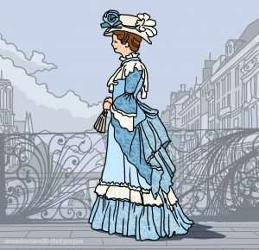
L’Ottocento vede Parigi come il centro con gusto neoclassico. Si ispira alle vesti della Grecia antica. Ma per il freddo intenso si ricorreva ad ampi mantelli drappeggiati in morbida lana o a come la redingote o lo spencer.
The 19th century has Paris as the center of the world. For women, the habit-chemise (which later became the chemise) triumphed. The girdle and the 'panier', which artificially designed the figure, were put to bed. Ladies preferred the simplicity and truth of the 'chemise' dress, which was redefined in 1920 with neoclassical taste. It was inspired by the garments of ancient Greece. But for the intense cold, wide draped cloaks in soft wool or English-inspired overcoats such as the redingote or the spencer were used.

Slide 17
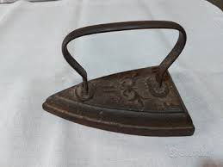
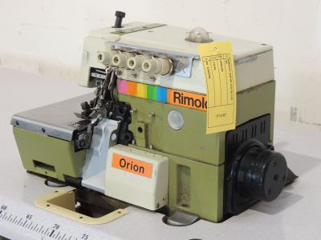
Henry Seeley in 1891 patented the iron that was heated by electricity, and in 1926 came the steam iron, which greatly alleviated the fatigue of ironing as the iron was lighter and removed creases more easily.
The first overlock machine dates back to 1889 and was designed in America by the Merrow Machine Company, a company that still produces these machines in a basic model.
In Italy, the first overlock machine was designed in 1920 by the Milanese company Virginio Rimoldi. The first model was named after Rimoldi's own wife, Stella.
It was in 1964 that the founders of the Juki Corporation redesigned the industrial overlock machine into a smaller and lighter model for easy use, even making them suitable for home use.

Slide 18
2. DIFFERENT TYPES OF FABRICS
To date, we can subdivide fabrics into different categories according to their origin:
ORGANIC fabrics
ECOLOGICAL fabrics
FABRIC OF ANIMAL origins
ARTIFICIAL fabrics
RECYCLED fabrics
RECYCLABLE fabrics

Slide 19
Topic:
2.1 BIOLOGICAL FABRICS
Organic textiles are made of vegetable textile fibres such as cotton, organically grown, or naturally grown (hemp and bamboo), the colours are of vegetable or mineral origin. Furthermore, in the manufacturing processes: workers' rights are protected, factories try to optimise production processes by avoiding wastage of water and energy, and efforts are made to reduce transport, especially by wheel or air.
Merino virgin wool/silk blends regulate warmth and moisture and promote a healthy skin climate; you will find this composition in some adult and children's underwear. The fabric consists of 70 % virgin merino wool from organic farming, kbT, and 30 % silk.
Organic wool: The virgin wool used for our underwear comes from merino sheep. The virgin merino wool is very finely crimped, does not pinch and is soft and fluffy to the touch. The wool comes from organic farming (kbT), where the sheep are kept well so that they live healthy and in peace. The use of pesticides is forbidden on pastures and animals. Furthermore, wool is repellent against dirt and regenerates in the air. It is advisable to wash the garments by hand without rubbing or wringing too much, putting them in lukewarm water to prevent them from infiltrating.
Although 100% wool is always proposed as a natural product, choosing organic wool means first of all paying attention to the treatment of the sheep, which do not undergo mutilation such as mulesing. Moreover, the processing is also more environmentally friendly, both for the environment, where the chemical waste from industrial processing is not spilled, and for our skin, which will enjoy the benefits of a natural fibre not distorted by chemical treatments.

Slide 20
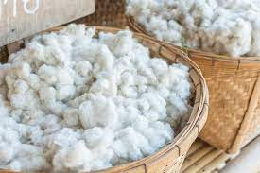
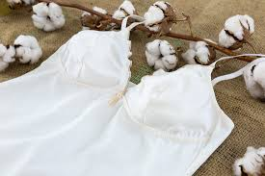
ORGANIC COTTON
The cotton is harvested from protected fields where no herbicides or pesticides of chemical origin have been used for at least three years. It is also guaranteed that during all stages of production, weaving and finishing no harmful substances are used, but everything is done dry. The fabric is therefore breathable, non-polluting and hypoallergenic, as the absence of chemicals reduces contact allergies. Organic cotton products have the advantage that they retain the fibre's characteristics and last longer.

Slide 21
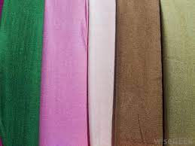
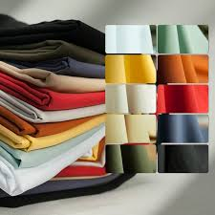
2.2 ECOLOGICAL FABRICS
Ecological textiles are produced according to standards and certified in terms of ecology and social responsibility. These standards guarantee that the raw materials from which the textiles or yarns are produced are truly organic and that strict rules of environmentally friendly production are followed along the entire production chain. These products are only certified if the standards are followed at all stages of the production chain.
As far as environmentally friendly textile fibres are concerned, from eucalyptus wood comes a type of fabric, Lyocell, which is an innovative man-made cellulosic fibre whose production process has a very low environmental impact. In recent years, ecological issues have had a bad reputation, especially in the textile and clothing industry. Every textile product leaves harmful waste to the environment. The traditional textile industry consumes large amounts of natural resources. It is very important to control pollution in the production process and to purify textiles from toxic effects. Sustainable natural fibres such as organic cotton, hemp and bamboo fibres have been developed through studies in this field.

Slide 22
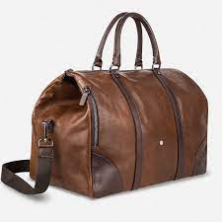
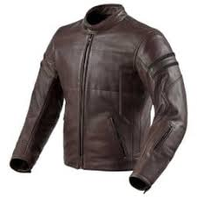
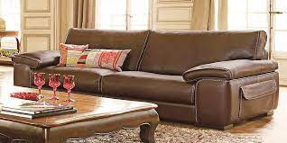
2.3 FABRICS OF ANIMAL ORIGIN
Animal skin is a waste product of the food industry: instead of being disposed of in landfills, it is, through the tanning process, used for the production of leather goods, furniture, clothing. No animal is killed for the sole purpose of using its skin.
Moreover, it is an anti-waste choice: the disposal of animal leather waste is an expensive and often far from sustainable process. Allocating them to the production of quality products with excellent durability cuts the costs of the food industry and contributes to the evolution of a more sustainable and environmentally friendly fashion.

Slide 23
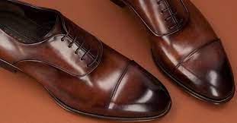
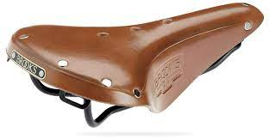
Leather is animal hide that, after appropriate manufacturing processes - which nevertheless maintain its fibrous structure - is tanned to prevent it from rotting. Leather is the tanned leather par excellence. Famous for its charm and timeless elegance, it is characterized by its typical brown coloring.
LEATHER TANNING
Tanning is nothing more than the chemical/physical process that makes leather rot-proof and suitable for processing. I put it a little hastily, in reality the actual 'tanning' is only one of the processes that lead to the finished product starting from the raw hide, a waste product of the meat industry (at least as far as bovine hides are concerned, which represent 70% of the hides used in the manufacturing sector).
There are, among many others, two main methods of tanning:
Vegetable
Chrome

Slide 24
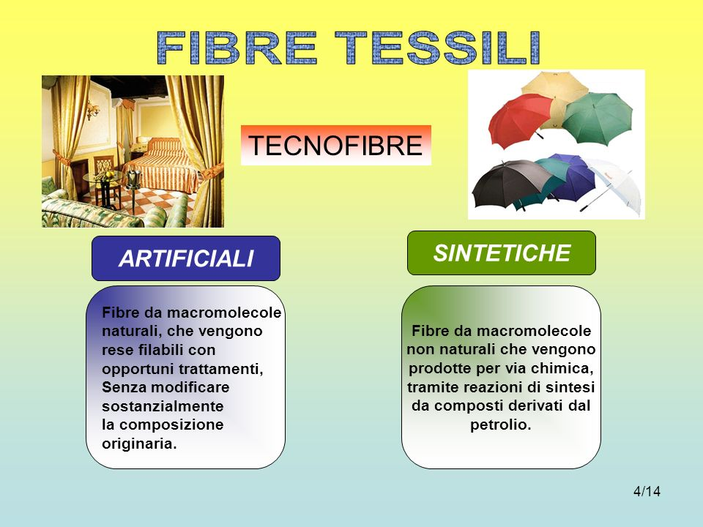
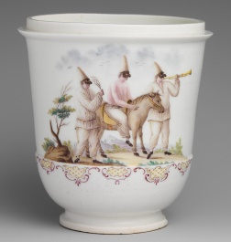
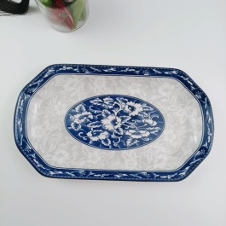
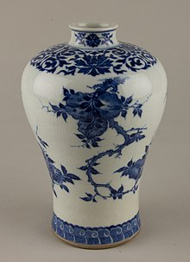
Soft porcelain produced in China differs from hard European porcelain in its lower proportion of kaolin (25-40%), its significantly lower burning temperature, poor transparency, and resistance to temperature changes. Soft porcelain is sometimes called frit due to the impurities or frit contained in it: sand, celite, sea salt, alabaster, alum, gypsum, lead, glass. Soft porcelain is most suitable for decorative purposes, such as the production of vases or figurines, due to its luster and glass texture (hence the fragility). Hard porcelain, meanwhile, is widely used in the manufacture of tableware because of its durability.

Slide 25
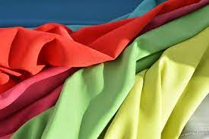
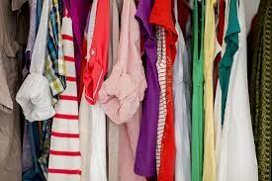
2.4 ARTIFICIAL AND SYNTHETIC FABRICS
These are man-made textile fibers that, to produce them, use compounds existing in nature such as cellulose, oil, water, nitrogen and other elements in small doses. They are divided into two large families: man-made and synthetic.
Man-made fibers are obtained from renewable raw materials, such as wood cellulose and cotton linters, and are fully comparable to natural fibers. Synthetic fibers originate from different polymers obtained through chemical synthesis and, with their innovative characteristics, represent the 'evolution of the species'.
The great advantage of man-made fibers is that they can be tailored to the specific applications for which they are intended. We can therefore have, according to need, fibers that are shiny or matt, elastic or rigid, soft or rough, delicate or ultra-strong, colored or transparent.
In the age of information, multimedia and scientific popularization, there unfortunately remain substantial areas of misinformation on important issues, which are still dealt with by resorting to stereotypes and clichés that should have long since been overcome.

Slide 26
Which fabrics can be recycled and which are the environmental benefits?
The use of PET to make recycled textiles helps enormously to reduce pollution, thus making the surroundings environmentally friendly. With the reuse of recycled fabrics, there is a large decrease in CO2 emissions in production processes compared to the production of virgin materials. Another advantage is that garments made from recycled polyester can be recycled over and over again, thus minimising waste. The use of recycled fabrics reduces pressure on resources, oil use and other chemicals used to produce synthetic fibres.
Below is a list of fabrics that can be recycled:
Polyester: recycled polyester fibres, also called rPet, are made by recycling plastic bottles and more. Although fabrics made from this fibre are not natural or biodegradable, recycling generates 54% less CO2 emissions into the atmosphere.
Cotton: recycling cotton involves optimising the energy and natural resources required. Cotton is the ultimate natural fibre, but tons of water and chemical pesticides are used to produce it (when it is not organic). As a result, mass cotton production is questioned because it has a great impact on our ecosystem.

Slide 27
Which fabrics can be recycled and which are the environmental benefits?
Nylon: Recycled nylon has the same advantages and disadvantages as recycled polyester. Being an artificial fibre, it takes many years to decompose. For this reason, it is better to use the recycled variant than the virgin one. Most of this fibre is made by recycling fishing nets, carpets and tights.
Wool: Using recycled wool is a good alternative because, in addition to preventing waste being generated in landfills, it avoids the expense of tons of water and chemicals used in the production process. There are various certificates to identify recycled wool, e.g. RCS (Recycled Claim Standard) or GRS (Global Recycled Standard).

Slide 28
2.5 RECYCLABLE FABRICS
Making textiles recyclable, extending the life of garments, making them easier to dispose of, combating counterfeiting and fast-fashion: all by 2030. The European Union approved its strategy for textiles on 31 March last, but there are many stages and they run until the end of the decade. It will be a supply chain approach, involving everyone from manufacturers to the governments of individual Member States.
'Fast fashion is out of fashion' is one of the slogans chosen for the European textile strategy. The clear reference is to the environmental repercussions of the numerous collections of clothes sold cheaply and made from often shoddy materials, most often destined for landfill.
Recycled fabric is fabric that has been made from waste material that is reworked into new fibres to weave a new fabric that is a new sustainable design to replace traditional synthetic fabrics. U-long produces recycled fabric, these high quality recycled polyester fabrics are made from plastic bottle materials! Recycled polyester is just as strong as virgin polyester, so don't worry, they both have the same texture, elasticity, abrasion resistance, moisture absorption and colour fastness. Thanks to its production process, it is much more sustainable and environmentally friendly than virgin polyester.
Responsible, traceable and measurable

Slide 29
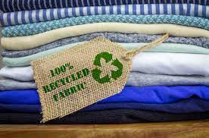
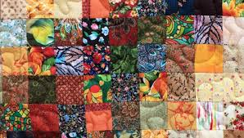
Recycling textiles is a sustainable practice that is beneficial to the environment. U-long's range of environmentally friendly recycled fabrics is certified to the Global Recycled Standard (GRS). It ensures that every textile production process is reliable in terms of traceability of recycling sources. This step will help reduce the carbon footprint left by the industry. It will thus help reduce the overall cost of textile production.

Slide 30
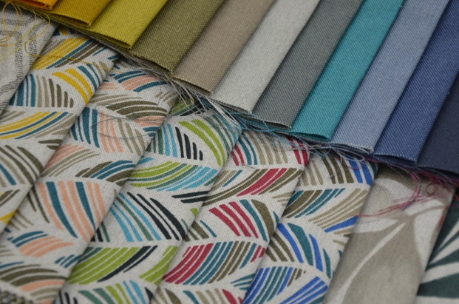
RECYCLED FABRICS
Here are 3 Recycled Fabrics:
1) SIRENA
The Sirena, whose polyester fibers are obtained from PET bottles recovered from the oceans, which undergo a refined recycling process and are transformed into highly efficient textile fibers. With this fabric we manage to recover as many as 5 bottles per square meter from the seas. The recycling process itself is completely non-polluting and certified. In this way, we succeed doubly in protecting the oceans by forming a true plastic virtuous circle, as we reuse the plastic already in circulation.
The composition of Sirena Recycled Fabrics, available in 28 colors, is as follows: 59% polyester recycled from the oceans, 41% cotton. Its weave allows it to be used for many purposes, such as the creation of advertising material and furnishing accessories.

Slide 31
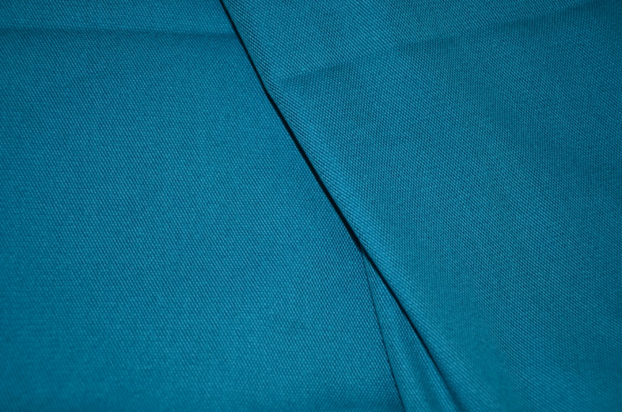
2) GOLENA
Golena is a fabric made from high quality polyester yarns obtained from the recycling of post-consumer plastic bottles and plastics recovered from the oceans. Composed of 50% recycled polyester and 50% cotton.

Slide 32
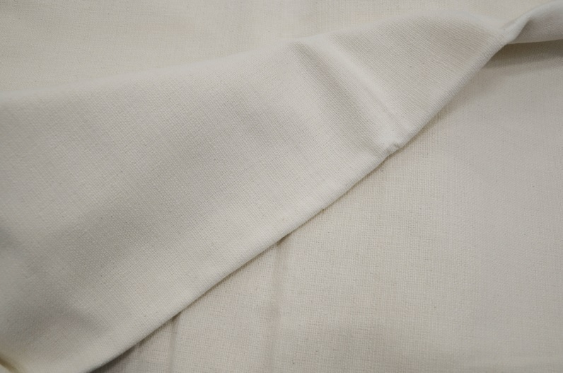
3) BAUMFENIX
Baumfenix is a 100% cotton made from a good 50% of yarns obtained from the recycling of discarded clothes and linen. Certified oekotex like our other recycled fabrics, it weighs 265 grams per square metre. It is suitable for various uses including the production of bags and shopper bags. Very suitable for customisation by printing.

Slide 33
QUIZ
What is an ecological tissues?
They are tissues obtained by chemical synthesis
Ecological textile products are produced according to standards and certified in terms of ecology and social responsibility.
Ecological textile are produced thank by sheets and animal like them.
What is a synthetic fabric?
Synthetic fibers originate from different polymers obtained by chemical synthesis.
Synthetic fibers originate from raw materials.
Synthetic fibers originate from animals.

Slide 34
ANSWERS
What are ecological tissues?
Answer: ecological textile products are produced according to standards and certified in terms of ecology and social responsibility.
What is a synthetic fabric?
Answer: synthetic fibers originate from different polymers obtained by chemical synthesis.

Slide 35
Which are the risks you face while you work with a sewing machine?
Fixed working positions: whether seated (sewing) or standing (cutting and ironing), held for prolonged periods of time, even in well-structured workplaces, are one of the main causes of spinal disorders during work.
In machine stitching and ironing: muscular pains are mainly caused by working with raised or otherwise unsupported arms; machine stitching by resting the forearms on well-designed work surfaces or by introducing periods of muscular rest, may reduce this danger factor.
Certain movements of the wrist and fingers: certain types of grip, when repeated frequently for a good part of the shift are particularly damaging to the tendons and nerves of the hand: one of the earliest symptoms is tingling and/or loss of sensitivity in the fingers during the night; phases of lesser use of the hands during the work shift will prevent the onset or aggravation of alterations.

Slide 36
Which are the risks you face while you work with a sewing machine?
Oculo-visual disorders: these can occur when objects are less than one meter away from the eyes, as the muscles for focusing the image and for ocular motility are heavily strained. The strain increases the closer or smaller the object is and the longer it is stared at. Also contributing to Rhythmic and continuous movements contribute to eye fatigue, for example, following the fabric sliding on the work surface and/or the machine needle.
Often the very structure of the sewing machine workplace forces one to assume positions that are harmful to the spinal column for long periods. For example, the presence of mechanical parts below the work surface, preventing the lower limbs from being accommodated, forces one to work with a flexed back and prevents one from resting the back against the backrest. The shoulder joint is also damaged by gripping objects behind the back and below.

Slide 37
Chemical risk: In the textile sector, the most well-known restricted substances are the carcinogenic aromatic amines released by azo dyes, as well as other groups such as:
biocides and synthetic catalysts in the production of polyurethanes;
phthalates;
nickel and cadmium in metal accessories;
perfluoro octane sulphonates (PFOS), hydro/oleo repellents and additives used in leather processing;
some flame retardants;
chromium compounds used in certain tanning and dyeing processes;
short-chain chlorinated paraffins, used for flame retardant treatments;
phthalates for which a change from restriction to authorisation regimes is foreseeable.

Slide 38
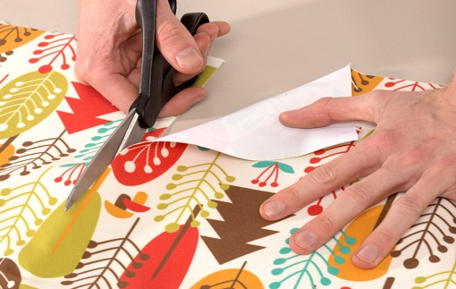
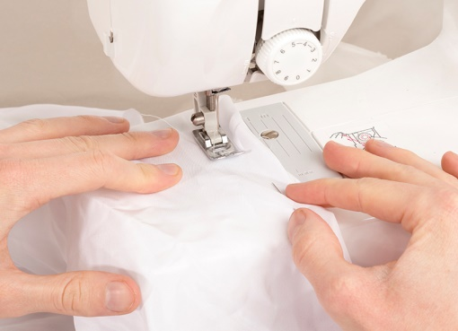
Are you new to sewing?
Follow this guide to the most common mistakes to avoid inconveniences or helping you eradicate form inaccuracies before they become commonplace.
Take good measurement before cutting. How to cut patterns:
What is the mistake? inaccurate cutting of fabric.
While cutting fabric using patterns, it is important to take the straight-thread into account. All fabrics are made up of a weft of threads, longitudinal and transverse. The intersection of the two threads at right angles is called the straight-thread, and it is important that the fabric is placed in straight-thread before cutting it, otherwise the garment will not have a good fit and you will run into other problems when sewing.
Lay the whole fabric on a flat surface, without the edges hanging out, as they could change the shape of the weave; always double-check that the patterns are in line, pin them on and start cutting. A wrong cut can compromise all the steps to achieve the final work, so be careful.
2. Lower foot well press fabric
What is the mistake? Improper use of the fabric presser foot.
The sewing machine's presser foot is used to keep the fabric stable and push it outwards for accurate and even sewing. Forgetting to lower the presser foot before sewing could push the fabric in all directions and result in tangles and abnormal seams.

Slide 39
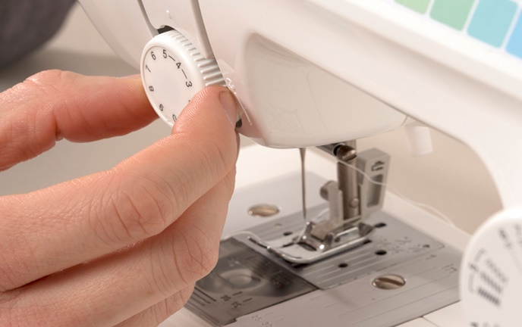
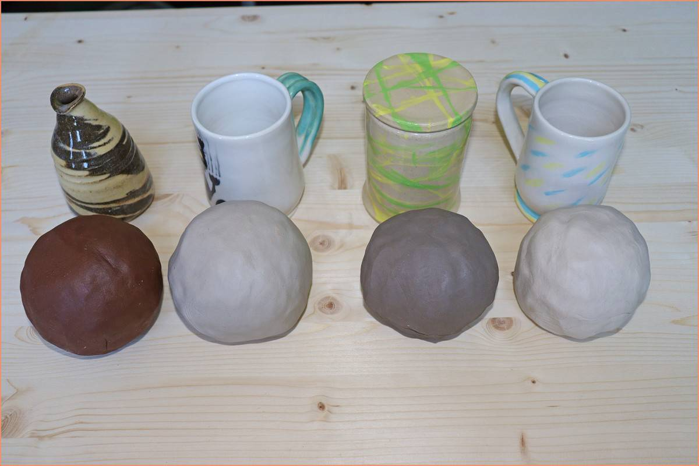
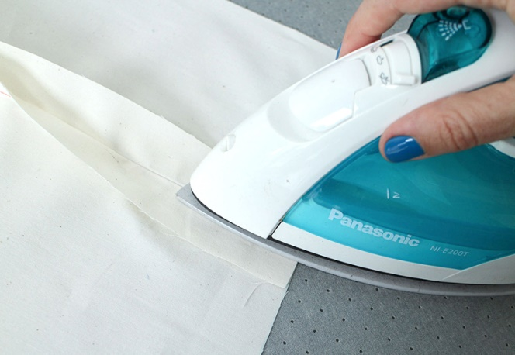
3. Select the right wire tension level
What is the error? Failure to check the wire coil voltage.
Getting the thread tension right is one of the most difficult skills to achieve, even for the most experienced seamstresses. The thread tension knob helps you adjust the thread tension and prevents the resulting seam from being uneven or too 'tight'. Check the thread bobbin, which is usually wound anti-clockwise, for imperfections before sewing. As a further safety measure, we recommend that you sew on a small test section several settings before proceeding with the actual garment, and make a note of which tension option is most suitable for your project.
4. Don't forget where the seams go
What is the mistake? Sewing on the wrong side of the garment.
In garment making, it is important to be able to sew accurately. One of the possible mistakes, considering that in order to check the sewing result on several sections you have to turn the fabric over, is to end up sewing the wrong side of the garment.
If you are sewing a garment with printed fabric, it is important to remember to place the two printed sides of the fabric in contact with each other as they will both be on the outside when the garment is finished. It is also important to remember to iron the fabric before starting the work, thus reducing the risk of inaccuracies due to creasing and uneven fabric tension.

Slide 40
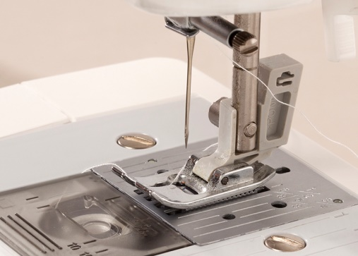
5. Check the thread and needle used
What is the mistake? Choosing an unsuitable thread and needle.
The choice of yarn to be used is very important. For most garments, 100% polyester thread is preferred because of its extreme versatility. However, we recommend checking the suggested uses of thread before starting your project because threads such as rayon, silk and basting thread are not suitable for all uses. There are many types of needles to be used in different situations, some more suitable for stretchy fabrics and some more suitable for stronger materials such as leather or even metal. In general, universal needles are more suitable for working with natural fibers while ball-point needles are more suitable for knitted fabrics. Each needle should be used for a maximum of 6-8 hours, so it is important to remember to change them at regular intervals to ensure that you always have a perfect seam.

Slide 41
QUIZ
What are the risks in sewing with machine and ironing operation?
Muscle pain
Neck pain
Back pain
What is the mistake while using the needle and thread?
Choose the wrong material
Choose the wrong machine
Choose an unsuitable thread and needle.

Slide 42
ANSWERS
What are the risks in sewing with machine sewing and ironing operation?
Muscle pain because is mainly caused by working with arms raised or not supported; machine sewing by placing the forearms on well-designed worktops or by introducing periods of muscle rest, may contain this danger factor.
What is the error in the use of the needle and thread?
Choose an unsuitable thread and needle. The choice of thread to use is very important. For most garments you prefer a 100% polyester thread for its extreme versatility. However, we recommend that you check the suggested uses of the thread before starting your project because threads such as rayon, silk and basting thread are not suitable for all uses.

Slide 43
3. HOW TO SET UP A SEWING ROOM
Choose the right room: Offices or guest rooms are perfect for converting into sewing workshops, as long as the room is large enough to hold a work table and serve as storage. If you can't afford to devote an entire room to sewing, carve out some space from a room used for other purposes; it is very important to make sure that the space you choose has easy and ample access to electrical outlets, to which you will connect your work tools, lamps and computers.
Choose work tools and sewing workshop furniture: An old computer desk can easily be converted into a sewing table, a chest of drawers can hold everything you need. Carefully consider the position of the bulkier furniture elements.
for example If you wish to place a cutting table, you must take into account that you will need easy access to all four sides and it must be large enough to accommodate the fabric for each of your projects. In addition, the table will need to be high enough to allow you to work standing up without giving you a backache.
3. Draw the room plan: Include the equipment and furniture established in step 2. The minimum equipment could be: a desk for the sewing machine, a cutting table, a small sofa, an ironing board, a small storage room and shelves.
4. Arrange the furniture and equipment as established on the floor plan: start with the storage furniture, proceed with the desk or sewing table, finish with the smallest and lightest tools.

Slide 44
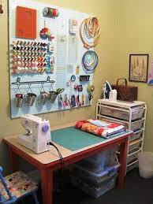
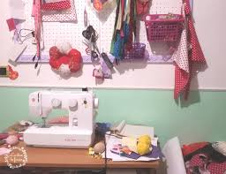
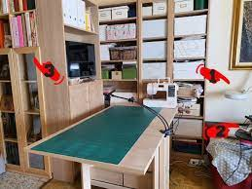
5. Choose what to keep in sight: This way you will immediately find what is most useful to you. For example, you can keep spools, needles, tape measure and pins on your desk at all times.
6. Paint the wall or apply wallpaper: Remember that cool colors (blue, green, purple) have a relaxing effect on the mind, while warm colors (red, pink, orange) have an exciting effect.

Slide 45
4. REPAIRING/ MENDING/ PATCHING
Repairing, patching, mending: the practice of repairing clothes, shoes and linens has many names. Although it is rarely mentioned in fashion and costume texts, it is an art that has been handed down from generation to generation for centuries.
For example, the life of a sack was long: after being mended, it became a floor cloth, as can still be seen today in cloths, which retain their textile form.
The term 'patching' has various synonyms: 'mending', ‘repairing', all words that indicate operations such as mending, adjusting, reassembling fabrics or various materials. According to etymological dictionaries, the term 'mending' is not very old; it became widespread in the second half of the 19th century 'to indicate the work that is done to reconstruct or reinforce the warp and weft in a torn or much used fabric'. Perhaps it comes from the word 'menda', which indicates a defect, stain or blemish, which more anciently referred to an error. According to an ancient custom of the Amerindian peoples, reported by Italo Calvino, at the end of the weaving process a menda, a small error, was left in the form of a hole, through which the divinity of the weaving could escape and not remain a prisoner of the work.

Slide 46
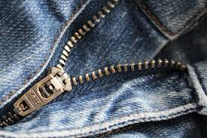
4.1 HOW TO REPLACE A ZIP
Changing a zip is something that we can easily do at home, i.e. without spending too much money to take the trousers, or the jacket, or the skirt, to a specialized shop that deals with this type of repair.
To change the zip, all we need is a pair of scissors, which we will use to gently undo the zip, taking great care not to damage the trousers. We unzip it from both ends, then starting from the left side, we insert the new zip, making the flap of fabric go inside and fix it with stitches (either manually or by machine).We repeat the same with the bottom end and the right side.
TUTORIAL: HOW TO REPLACE A ZIP
https://www.youtube.com/watch?v=zTomNZg220g

Slide 47
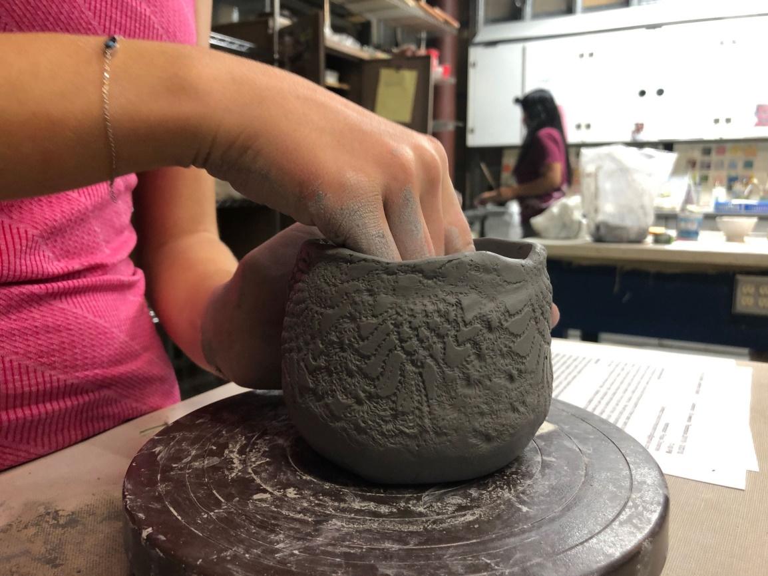
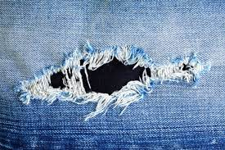
4.2 SEWING UP A TEAR MANUALLY
To repair a tear on any garment, choose a cotton thread, or other necessary material, of the same color as the torn garment.
Turn the garment inside out
Follow the direction of the tear
Take a needle and thread about 50cm long, insert it into the needle
Join the two torn edges and starting from one end, insert the needle on the untorn fabric and repeat small stitches, even fairly close together.
Finish with 2 overlapped stitches.
Turn the garment inside out and iron it.
TUTORIAL OF A STITCHING ON TROUSERS
https://www.youtube.com/watch?v=sDi-9LTxNC0

Slide 48
4.3 HOW TO STITCH A PATCH
Choose a patch color that matches the color of the knit. If you do not have a sewing machine, you can sew the patch by hand. Whether you sew it by hand or by machine, you will need a needle with a round tip to avoid the risk of stretch marks during sewing. If you decide to sew by hand, skip the steps concerning machine sewing.
Lay the shirt on a flat surface, with the tear facing upwards.
Measure the length of the tear.
Measure the width of the tear.
On a piece of paper, mark the ends of the tear length, adding 2.5 cm.
Mark the center of this distance with a dot.
Starting from the point, turn the tape measure 90 degrees and mark the extremes of the tear width, adding 2.5 cm.
Draw a curved line joining the four extremes.
With a straight line connect the ends of the width, passing through the center.
Handbuilding is a ceramics technique that allows you to create forms with clay and your hands, without using a throwing wheel. Before ceramicists invented the wheel, handbuilding was the only way they could create functional and artistic ceramic forms. The oldest known ceramic artifact was handbuilt and is dated as early as 28,000 BCE. All you need to get started are your clay, your hands, and a few simple tools.

Slide 49
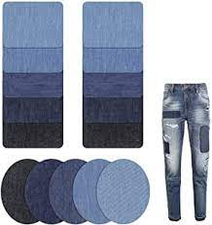
Fold the piece of paper in half along the drawn line.
Cut along the curved line.
The resulting piece of paper will serve as a template for the patch.
Lay the template on the tear, checking that the shape and dimensions fit.
Lay the template on the tear, checking that the shape and size fit.
Fix the pattern onto the piece of fabric with pins.
Using the tailor's scissors, cut along the contour of the pattern.
Check the patch, going over the edges well with the scissors if there are parts to be finished.
Handbuilding is a ceramics technique that allows you to create forms with clay and your hands, without using a throwing wheel. Before ceramicists invented the wheel, handbuilding was the only way they could create functional and artistic ceramic forms. The oldest known ceramic artifact was handbuilt and is dated as early as 28,000 BCE. All you need to get started are your clay, your hands, and a few simple tools.

Slide 50
Place the patch on the tear, in the exact place where you want to sew it, and secure it with pins
Insert a round-pointed needle into the sewing machine.
Place the shirt sleeve on the free arm of the sewing machine, just as you would when wearing it.
Place the edge of the patch under the sewing machine needle.
Sew along the entire contour of the patch, turning the sleeve as you go.
Continue sewing around the entire perimeter of the patch, going over the initial stitches.
Remove the sleeve from the free arm of the sewing machine.
Cut off excess threads.
If patches are desired on both elbows, repeat the same procedure on the other sleeve.
TUTORIAL ON HOW TO APPLY A PATCH TO TROUSERS
https://www.youtube.com/watch?v=UYK82vyvVGc

Slide 51
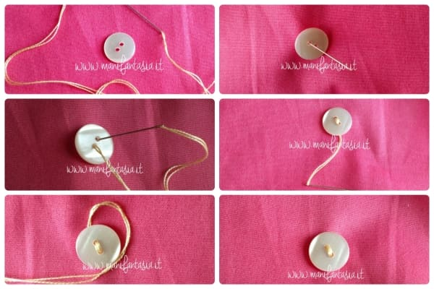
4.4 HOW TO SEW ON A BUTTON
Choose your button and thread. Choose a suitable button and thread to match the button, the garment and the thread used for the other buttons. If you prefer, you can double the thread to make your work easier.
Thread the needle. Simply insert the thread into the needle so that the length of the two ends is the same on both sides.
Make a knot at the end of the thread. One method of tying a knot is to wrap the thread around your finger (as you can see in the photo), roll it between your fingers and pull tight. If you double the thread, knot the ends. Make sure the thread is long, either single or double.
Place the button on the fabric. Align the button with the others on the garment. Also check the button hole. Bring the button close to the buttonhole (the part of the shirt that runs all the way along the vertical and on which there are buttonholes), at the point corresponding to where you want to sew it, and make sure it is in line with the button hole.
Insert the needle into the fabric and into one of the button holes. Pull the thread all the way through each time you sew a stitch.
Place a pin. Insert a pin under the button between the stitch you made and the next one to avoid sewing the button too tight. Then, push the needle into the next hole and then into the fabric. Pull all the thread through. It is best to hold the button down so that it does not move.

Slide 52
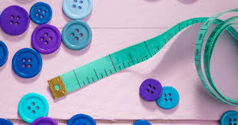
7. Start again. Insert the needle in the first hole and pull the thread through the fabric.
8. Reinforce the button. Repeat the process until you are sure you have attached the button firmly.
9. When you need to do the last stitch, insert the needle into the fabric, but not into the button holes. Remove the pin.
10. Wrap the thread. Wrap the thread six times around itself between the button and the fabric to reinforce the stitch you have given.
11. Thread the needle from top to bottom through the fabric.
12. Sew three or four stitches to secure the thread. Give a few stitches under the button, one way and the other, to reinforce it. Knot the thread. Cut off excess thread.
WATCH THE TUTORIAL https://www.youtube.com/watch?v=gfUVuG2nkO4

Slide 53
SUMMARY
In this module, we have studied the birth of the art of sewing, from Prehistory to the present day.
We also looked at different techniques:
How to replace a zip
How to manually sew up a tear
How to insert a patch
How to sew on a button
Reporting TUTORIALS of the different techniques.

Slide 54
QUIZ
What do you need to replace a zipper?
Thread and needle
Pair of scissors
Sewing machine
Do you need a machine to sew a patch?
Yes, I do.
No, I don’t.
I can use my hands.

Slide 55
ANSWERS
What do you need to replace a zipper?
Answer: a pair of scissors.
Do you need a machine to sew a patch?
Answer: I can use my hands.
Whether you sew it by hand or machine, you will need a round - tipped needle to avoid the risk of stretch marks during stitching.

Slide 56
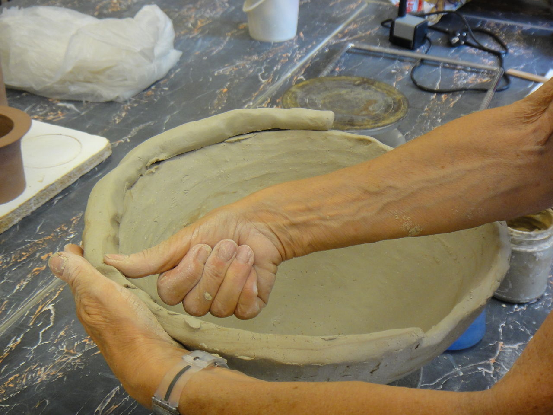
REFERENCES
https://www.wikihow.it/Cucire-un-Bottone
https://it.ifixit.com/Guida/Applicare+una+toppa+per+gomiti+su+una+maglia+Patagonia/19440
https://www.zummy.it/limportanza-del-riciclo-e-del-sistema-circolare-nella-moda/#:~:text=Con%20il%20riutilizzo%20di%20tessuti,ridurre%20al%20minimo%20gli%20sprechi
https://www.frareg.com/it/sicurezza-sul-lavoro/quali-sono-i-rischi-per-la-sicurezza-nel-lavoro-con-la-macchina-da-cucire/
https://www.federchimica.it/la-chimica-per/vita-quotidiana/le-fibre-artificiali-e-sintetiche
https://www.borettini.it/blog/tessuti-riciclati/
https://www.ekolojik.com.tr/it/sektorel-ipuclari/ekolojik-tekstil-nedir/
https://vestirebio.it/informazioni/informazioni-tessuti-biologici-ecologici.html
https://www.puntosicuro.it/industria-tessile-cartaria-C-22/i-rischi-per-la-salute-nel-settore-tessile-AR-16004/
https://www.puntosicuro.it/industria-tessile-cartaria-C-22/comparto-tessile-abbigliamento-i-rischi-per-la-salute-la-sicurezza-AR-16871/
https://www.areadomani.it/storia-della-moda-una-storia-damore-da-tutta-una-vita/
https://www.quiamagazine.it/lincredibile-viaggio-dei-bottoni-dalla-preistoria-ai-giorni-nostri/
https://www.lartedelfare.it/sviluppo-del-cucito-creativo/

Slide 57

You've just finished the chapter of
«REPAIRING/ MENDING/ PATCHING »

Slide 58
5. MODIFYING A GARMENT
Shrinking clothes at home can be difficult because each garment reacts differently (some do not even shrink). It is also important to take the right precautions to avoid damaging clothes or shrinking them too much.
5.1 SHRINKING NEW CLOTHES BY WASHING THEM
Read clothing labels. Each fiber (such as wool or cotton) shrinks in a particular way, so you need to determine the composition of the fabric before washing it. For example, wool is a delicate material that tends to shrink in the tumble dryer. Cotton, on the other hand, is more durable, so you have to set the tumble dryer to a higher temperature. Silk generally shrinks by about 8-10% in the washing machine. Determine whether the garment has been pre-washed or not. New clothes usually shrink on the first wash. Pre-washed ones tend to keep the same size, so tailoring changes may be necessary.
Wash the garment in warm water. You can do this by hand or in the washing machine. If you decide to do it by hand, bring a pot of water to the boil. Immerse the garment and let it boil for a few minutes, then remove the pot from the heat. Do not use fabric softeners!

Slide 59
Place the garment in the tumble dryer. If it is cotton, set it to a high temperature, checking regularly to see if it has reached the desired size. At this point, remove it from the dryer and complete the air-drying process to prevent it from shrinking further. If you want it to shrink more, leave the garment in the tumble dryer. For polyester and wool, set the tumble dryer to a medium temperature and wait until it is dry.
Try on the garment. Determine if it has reached the desired size. The beauty of being able to change the size of a dress is that you can usually shrink it further or enlarge it if you have overdone it.
Repeat the process. Do this as many times as necessary until the desired size is obtained. Remember that a dress shrinks mostly during the first wash. If you want to shrink it further, then you could have it altered by a tailor.

Slide 60
5.2 SHRINKING A TROUSER MANUALLY:
All you need are: PINS, CHALKS, NEEDLE, THREAD AND A GARMENT METRE.
Turn the trousers inside out and lay them on a work surface.
We start from the waist and move 18 to 20 cm down.
We measure the circumference of the waist, divide the measurement into 2, and divide it further into 2. We mark all these measurements with chalk.
We join all the dots with chalk.
Marking with needle and thread, close-up stitches
Try on the garment
Sewing by machine or by hand
FOLLOW THE TUTORIAL https://www.youtube.com/watch?v=C-K429gamf4

Slide 61
5.3 HOW TO WIDEN A TROUSER
Unbutton the entire side of the trousers
Cleanly cut the waistband
Regardless of whatever fabric you are working with, consider the cm you are adding, and add an extra 1cm on both the right and left sides
Add a band of e.g. 10cm to the height of the waistband
We proceed with machine or hand stitching, from top to bottom.
We close the hem of the trousers, turning and turning, to reach the length of the trousers
Same procedure for the belt part.
FOLLOW THE TUTORIAL https://www.youtube.com/watch?v=H4PjwbfEOns

Slide 62
SUMMARY
In this module, we dealt with two techniques related to the modification of a garment:
HOW TO WIDEN A TROUSER
HOW TO SHRINK A TROUSER
And a step-by-step explanation, both of the processes performed manually and using the sewing machine, please also follow the included tutorials!

Slide 63
QUIZ
What do I need to shrink a trouser manually?
Needle, thread and a meter for tailors.
A sewing machine.
Pins, Chalks, needle, thread and a meter for tailors.
Where we wash our clothes to shrink them?
Cold water
Hot water
You do not need to wash your clothes to shrink them

Slide 64
ANSWERS
What i need to shrink a trouser manually?
Answer: pins, plaster, needle and thread and a meter for tailors.
Where we wash our clothes to shrink them?
Answer: we wash our clothes in hot water.

Slide 65
REFERENCES
https://unor.online/it/come-restringere-la-gamba-di-un-pantalone/
https://www.wikihow.it/Restringere-i-Vestiti
https://www.stylight.it/Magazine/Fashion/Come-Allargare-Allungare-Accorciare-Un-Vestito/#:~:text=Basta%20una%20bacinella%20con%20acqua,con%20forza%20ma%20senza%20risciacquarlo
https://www.donnemagazine.it/come-allargare-un-vestito/
https://www.wikihow.it/Allargare-i-Vestiti-Ristretti
https://www.unideanellemani.it/come-allargare-pantaloni-jeans-in-vita-tutorial
https://itchiedendo.com/come-allargare-un-pantalone/
https://www.piudonna.it/come-allargare-i-pantaloni-troppo-stretti-il-trucco-semplicissimo-anche-per-chi-non-sa-cucire-ecco-come-si-fa-in-due-mosse/
https://www.momentocasa.it/fai-da-te/allargare-pantaloni-troppo-stretti/

Slide 66
You have just completed the module of:
<<HOW TO MODIFY A GARMENT>>

Slide 67

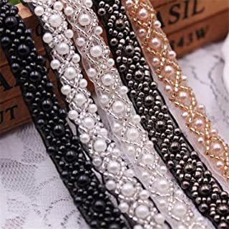

6. DECORATING FABRICS
WHAT IS DECORATION?
The term decoration encompasses all ornamentation of objects or architectural elements of buildings that have a rhythm of line, or geometric or figurative relief, or color. Decoration is a form of applied art, called minor in antiquity, that makes objects, furnishings, textiles aesthetically pleasing and differs from the fine arts, which instead aims to provide intellectual and aesthetic stimuli rather than functional ones. Decoration consists of those elements that serve to embellish. In art and architecture, one can decorate an art object or a building. One can decorate something by painting it or attaching elements to it. The Romans decorated their houses with mosaics (e.g. in Pompeii there are mosaics, wall paintings or foreshortenings). Decoration is a very broad field, encompassing the transformation, arrangement, restoration, repair of a human habitat and interior furniture.

Slide 68

6.1 MAKING A FABRIC FLOWER
A fabric flower can be used to mend a hole and hide a burn, or add a touch of style to a favorite jacket. You can make delicate tulle flowers to embellish the bodice of a dress with a full skirt, or a checked dress for a picnic or a trip to the countryside. With a few petals in lightweight fabric, such as tulle or impalpable chiffon, you can also create water lilies perfect for embellishing your bedside table or bookshelf at home. With a floral touch of color you will make even the most anonymous and industrial wall decoration unique. With a little hot glue, some fabric of your choice, needle and thread and a sewing machine, you can make wonderful brooches to pin on your elegant dress. A winning and interesting idea is to recover recycled fabrics and materials to create a flower to pin on a handbag with your own hands.
In the following link you will see how to create a fabric flower
https://www.youtube.com/watch?v=butebY_awRw

Slide 69

To bring an air of Spring into the home and onto clothing, many fabric flowers can be made. There are many techniques for making fabric flowers and in many cases they are also very simple to make, suitable even for those who have never picked up a needle and thread. Let us see together what they are and all that is needed to make them. Fabric flowers can also easily be used to decorate bags, T-shirts, hats, aprons, headbands and hairpins for little girls, or to create handmade brooches, magnets, or cute place cards. So let's find out how to make fabric flowers thanks to this tutorial also recommended for those who are not familiar with needle and thread.
Equipment:
A card
Cotton fabric in two different colours/patterns
Needle and thread
Scissors
A medium-sized button, about 2cm in diameter will do
Padding wadding or cotton wool
Hot glue

Slide 70

Procedure:
Cut out a circle with a diameter of approximately 7cm from a card. This will serve as a paper pattern to easily create all the petals of the flower.
Draw 5 circles on the back of the selected fabric using the paper pattern you have just created and cut them out with scissors.
To form a petal, pass the needle and thread around the entire perimeter of the fabric circle, leaving approximately 0.5 cm from the edge.
Pull the thread with your fingers until the fabric closes in on itself. Before closing it completely, insert a ball of cotton batting or cotton wool inside the fabric.
Pull the thread to close the petal and tie a double knot to secure the position.
Repeat the above steps to create four more stuffed petals for our fabric flower.

Slide 71

To create the flower pistil, select a fabric of a different color and pattern and cut out a circle.
Place a button of approximately 2 cm in diameter on top of the circle of fabric, and again with needle and thread, baste the edge of the circle, keeping a distance of a few millimeters from the edge. Having basted the entire diameter, pull the thread so that the fabric closes and the button is included inside.
Secure the position with a double knot.
To join all five petals together, pass the needle and thread through the bottom of each petal, connecting them to each other.
Pull the thread so that the petals come together and create the corolla of the flower.
Tie a double knot
Overlap the fabric-covered button in the center of the flower corolla and stick it on with hot glue
Our fabric flower is ready!

Slide 72

Tips:
To create a magnetized flower perfect for hanging our favorite photographs on the fridge, simply stick a disc magnet on the back, which is easily available at a low price. Similarly, to embellish a headband, a hairpin or create a brooch with the fabric flower, simply glue the flower onto the surface with hot glue
Experiment with color combinations and different fabric patterns to obtain many original fabric flowers that are different from each other. With the exact same technique you can also try making little flowers out of pennogenin, an even easier material to work with than cotton.
Enjoy your creation!

Slide 73

6.2 HOW TO SEW SEQUINS ONTO FABRIC
Adding sequins is a great way to give an extra touch to an overly flat outfit. Sequins are an essential element of many costumes, from dance costumes to circus costumes, so if your children need original costumes, it always comes in handy to be able to sew sequins onto the fabric. All sequins are applied with normal thread or transparent thread. This module explains how to apply sequins correctly.
THINGS YOU WILL NEED:
Long, thin needle
Fine, strong thread
Sequins

Slide 74
THE STEPS:
STEP 1: Start with a suitable thread, long enough and knotted at the end. The thread should be thin and strong; cotton or silk threads are good because they are natural, whereas polyester tends to last longer. Put the needle and thread on the back of the fabric, where you want to apply the sequin. Match the color of the thread to the sequin, rather than to the fabric.
STEP 2: Place the sequin on the straight side of the fabric, carefully, placing it exactly where you want it to stay at the end.
STEP 3: Bring the needle upwards through the fabric. Pass it through the center of the sequin, leaving plenty of thread on the back of the fabric.
STEP 4: Return to the wrong side of the fabric. Pass the thread through the sequin.
STEP 5: Knot the ends of the thread together on the back so that they are firmly in place.
STEP 6: Move on to the next sequin. The more you apply sequins, the quicker you will become at repeating the movements. When sewing sequins in a row, check that they do not overlap - unless that is the end result you want to achieve.

Slide 75

TIPS
You can make several passes with the thread through and over the sequin to stop it better. Two passes stop the sequin well in place, three passes (forming a 'Y' with the thread on the sequin) should make the sequin resistant even to machine washing.
Look at the decorations on the clothes you find in shops, so that you can see how they are applied. Often sequins are applied in a row, but without the knot on the back. This makes it faster, but also less secure.
To hide the thread, apply each sequin with a bead in the middle. This way the thread is not visible and the sequin has an extra touch.
You can find sequins in various shapes, e.g. circles, flowers and stars.
Use matching or contrasting colors to achieve different effects.
When choosing sequins, be guided by price. The more expensive they are, the more durable they are and the longer their color will last, whereas cheap ones tend to fade quickly.

Slide 76

PRECAUTIONS
Beads and threads can break: do not leave sequin-decorated objects in the hands of children under 3 years old, as they can get hurt if the pieces break.
Do not cut sequins with scissors as they can damage the blades. If you have to remove sequins from the fabric, cut the thread, not the sequin.

Slide 77

Question with 3 options as answers and only one correct answer
Reply in Correct answer:
“ Your Answer is correct and explanation why “
Reply in Wrong Answers:
“ Your answer is wrong! The correct answer is….. And why “
You can create maximum 6 quizzes
SUMMARY
In the following module we have discussed about the art of decoration, the etymology of the word decoration and how to create a fabric flower to add a touch of style to clothes. You will also find the links that will show you how to create a fabric flower.

Slide 78
QUIZ
Which are the procedures to create a fabric flower?
Draw 5 circles on the back of the selected fabric using the paper pattern just created and cut them with scissors.
Draw 15 circles on the front of the selected fabric using the paper pattern just created.
Draw 20 circles on the back of the selected fabric using the paper pattern with your needle.
Which are the procedures to sew paillettes on fabric?
To hide the thread, apply each sequin with a bead in the center. This way the thread is not visible and the sequins has an extra touch.
You could not find sequins of various shapes, such as circles, flowers.
You must use only one color.

Slide 79
ANSWERS
What is one of the points for the procedure to create a flower of fabric?
Answer: Draw 5 circles on the back of the selected fabric using the paper pattern just created and cut them with scissors.
What is one of the points for the tip to sew paillettes on fabric?
Answer: To hide the thread, apply each sequin with a bead in the center. This way the thread is not visible and the sequins has an extra touch.

Slide 80
Question with 3 options as answers and only one correct answer
Reply in Correct answer:
“ Your Answer is correct and explanation why “
Reply in Wrong Answers:
“ Your answer is wrong! The correct answer is….. And why “
You can create maximum 6 quizzes
REFERENCES
https://www.treccani.it/vocabolario/decorazione/
https://it.wikipedia.org/wiki/Decorazione#:~:text=La%20decorazione%20%C3%A8%20costituita%20da,dipingendola%20oppure%20attaccandovi%20degli%20elementi.
https://bouquetalternativi.it/fiori-di-stoffa/
https://www.filidiluce.org/la-moda-le-origini-la-storia-2/
https://www.wikihow.it/Cucire-le-Paillette-Sulla-Stoffa#:~:text=Metti%20la%20paillette%20sul%20lato,vuoi%20che%20rimanga%20alla%20fine.&text=Porta%20l'ago%20verso%20l,filo%20sul%20retro%20della%20stoffa.&text=Torna%20sul%20rovescio%20della%20stoffa.
https://www.tessutietendaggipanini.it/blog/come-creare-fiori-di-stoffa/

Slide 81

You have just completed the Module
<<DECORATING FABRICS>>

Slide 82
Question with 3 options as answers and only one correct answer
Reply in Correct answer:
“ Your Answer is correct and explanation why “
Reply in Wrong Answers:
“ Your answer is wrong! The correct answer is….. And why “
You can create maximum 6 quizzes
7. HOW TO BREATHE NEW LIFE INTO CLOTHING AND ACCESSORIES
7.1 RECYCLING CLOTHES AND THE ENVIRONMENT
Recycling clothes is necessary to fight global warming. By giving clothes a second life, the environmental impact of textile products is significantly reduced.
The first action to reduce textile waste is to use these products responsibly:
Choose good materials, such as linen, which requires less water and fertilizer to grow, or organic cotton;
Buy clothes made from recycled fibers;
Buy second-hand clothes in second-hand shops or online second-hand shops, so you can also save money;
Favor brands that are committed to the environment;
Pay attention to labels that make it easier to recognize certain characteristics of a product, such as the guarantee of origin.

Slide 83

Question with 3 options as answers and only one correct answer
Reply in Correct answer:
“ Your Answer is correct and explanation why “
Reply in Wrong Answers:
“ Your answer is wrong! The correct answer is….. And why “
You can create maximum 6 quizzes
7.2 THE LIFECYCLE OF CLOTHES
Knowing the life cycle of clothes is one way to understand the impact of your carbon footprint. In fact, all stages of this life cycle have an impact on the environment:
The production of raw materials: clothes are produced from raw materials such as polyester, cotton, silk or wool. Some of these are derived from non-renewable resources, such as oil, to produce synthetic fibers, while others are derived from plant or animal materials and therefore require a lot of water and chemicals.
The manufacture of clothes: because of the substances it contains, dye is toxic not only to the workers who make the clothes, but also to consumers and the aquatic ecosystem it contaminates.
The transport of clothes: they are generally manufactured in developing countries, where production costs and wages are lower, and the clothes are transported to Europe by air or sea. In any case, air transport is the most polluting means of transport.
The maintenance of clothes: excessive water consumption, washing clothes releases a large number of micro polluting particles.
Recycling used clothes: this is a crucial step. Sorting one's wardrobe and recycling some used clothes helps to prolong the life of the fabric, thus avoiding unnecessary steps such as the production of raw materials, the manufacture of products or even transport.

Slide 84


Taking care of your clothes not only preserves them for longer, but also saves money and limits your impact on the environment;
Wash less and choose eco-labelled detergents to limit the emission of toxic substances into the oceans;
Save water and energy by washing your clothes at only 30°C and avoiding using the dryer;
Fix your clothes and give them a second life.
How to recycle old clothes?
Choosing your clothes and sorting them is equivalent to giving them a second life. This minimizes the impact of textiles on the environment and also reduces your carbon footprint.

Slide 85

7.3 Reuse and customize: a guide to second-hand clothes
Another option is to reuse and customize used clothes: use them as a base for different garments, modify them, etc.
Use clothes in a different way, for example, use a man's shirt as a dress by wearing it with socks and a belt;
Add new details to used clothes;
Remove parts of clothes to turn a jacket into a waistcoat, for example, or long trousers into shorts;
Dye clothes.

Slide 86
7.4 LABORATORY: How to create a handbag from recycled jeans
Everyone has at least one old pair of worn-out, out-of-fashion or wrong size jeans in their wardrobe. With this tutorial I will show you how to turn them into a colorful bag perfect for summer! I also recommend you take a look at the tutorial for making a matching wallet from scraps of fabric. If, on the other hand, you would like a shoulder bag, you can read how to make a denim purse.
Needed:
jeans;
colored cotton fabric for the lining;
needle and thread.

Slide 87

STEP 1: First measure approx. 40 cm starting from the waist, draw a line with chalk and cut off the 'legs' (keep them aside as you will need them!). Stitch all along the crotch, also at the back.

Slide 88





STEP 2: Fasten the waistband with pins, this is because jeans are usually lower at the front and higher at the back, the bag, on the other hand, should be all the same height. You can now close the front slit of the crotch

Slide 89


STEP 3: Fasten the waistband with pins, this is because jeans are usually lower at the front and higher at the back; the bag, on the other hand, should be all the same height. You can now close the front slit of the crotch

Slide 90




STEP 4: To close the back slit, proceed as follows: cut out a rectangle from one of the legs, fix it under the triangular slit and sew all around.

Slide 91




6° STEP: Sempre dall’interno cucite gli angoli della borsa per creare un fondo più capiente. 6° STEP: Sempre dall’interno cucite gli angoli della borsa per creare un fondo più capiente.
STEP 5: Turn the jeans inside out and sew the bottom.
STEP 6: Still from the inside, sew the corners of the bag to create a roomier bottom.

Slide 92




STEP 7: This is how it should look when upside down
STEP 8: Now we move on to the lining: take the measurements of the bag and create a pouch - sewn on the bottom - of the same size with about 5 cm more in height.

Slide 93





STEP 9: Before attaching the lining, let's prepare the handles; to give more color to the bag I decided to make them half in jeans and half in the same fabric as the lining. In all you need 4 rectangles, 2 of denim and 2 of cotton, 5 cm wide and about 60 cm long. Remember to leave 0.5 cm around the perimeter for the seams!

Slide 94






STEP 10: Now we can assemble the various pieces: sew the handles first and then the lining.
TUTORIAL 'how to make a bag from a pair of jeans
https://www.youtube.com/watch?v=YIGIXkybkKc

Slide 95
SUMMARY
In this way, we emphasized the importance of RECYCLING old clothes and accessories, giving them new life. Not only is it important and increasingly popular to use second-hand clothes in good condition, but also to be able to give new life to clothes by creating unique pieces! In addition, we have reported the explanation and tutorial, of the creation of a handbag from an old pair of used jeans!

Slide 96
QUIZ
What is the first action to reduce textile waste in order to use these products responsibly?
Buy clothes that are from chemical products and that are branded.
Choose good materials, such as linen, which requires less water and fertilizers to grow, or organic cotton.
Do not buy clothes made from recycled fibers.
How do we reuse and customize: second hand clothes?
Add new clothes and gives second hand clothes.
Do not use your clothes differently.
Just dye your clothes.

Slide 97
ANSWERS
What is the first action to reduce textile waste is to use these products responsibly?
Answer: Choose good materials, such as linen, which requires less water and fertilizers to grow, or organic cotton.
How do we reuse and customize: second hand clothes?
Answer: Just dye your clothes is one of the many things we can do for reuse and customize our second hand clothes.

Slide 98
REFERENCES
https://climate.selectra.com/it/riciclo/vestiti
http://www.thecreativelab.it/it/accessori/tutorial-come-riciclare-un-vecchio-paio-di-jeans-per-creare-una-borsa/

Slide 99

You have just completed the module
<<HOW TO GIVE NEW LIFE TO CLOTHES AND ACCESSORIES>>
The module on TAILORING is accomplished! Time to pick up your needle, thread and get to work!

