Slide 1
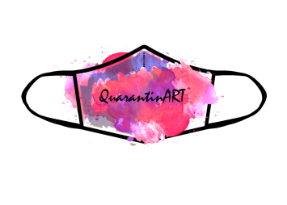
QuarantinART Inspiring Adults explore their artistic side KA227-5C93146E KA2 - Cooperation for innovation and the exchange of good practices KA227 - Partnerships for Creativity
Module: Ceramics ETC… Topic: 1,2,3,4
Developed by: Tavo Europa

Slide 2
INDEX
Objectives [pg: xx]
1.1 Theoretical introduction to the art of ceramics: [pg: xx]
1.2 Gaining basic practical skills: [pg: xx]
1.3 Creating an art project [pg: xx] etc
Tips [pg: xx]
Quiz [pg: xx]
References [pg: xx]
This information will be in clickable boxes

Slide 3
Objectives
1 To develop basic practical skills of women in ceramics.
2 Increase the employment and opportunities of low-skilled women through pottery.

Slide 4
Module Description
In this module a new and particular art it’s explained, the women could learn how to make ceramics products. The training introduces basic pottery practices and teaches women basic skills. More attention is being paid to practices and methods that are easily adaptable to home conditions, thus enabling more women to get involved and benefit.
Practical skills and key competencies are acquired to promote women's employment and increase opportunities. Low-skilled women are empowered to have greater creative, social and economic potential. At the same time, it is an opportunity to overcome the challenges of quarantine.

Slide 5
1.1. THEORETICAL INTRODUCTION TO THE ART OF CERAMICS.
This topic aims to present the theoretical side of the art of ceramics and will cover the following:
Sub-Topic 1 Possibilities of ceramics
Sub-Topic 2 Techniques and tools
Sub-Topic 3 The right creative environment

Slide 6
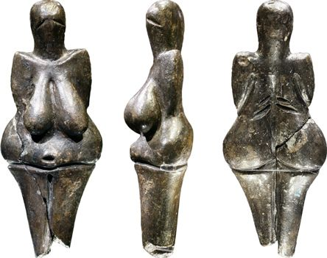
Topic: POSSIBILITIES OF CERAMICS
History
The first human-made pottery discovered dates back at least 24,000 years BC. It is a small statue called Venus of Dolní Věstonice, discovered in a settlement near Brno, in the Czech Republic.

Slide 7
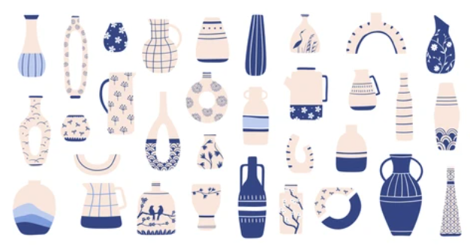
The first pottery in Asia was discovered several thousand years later at the Xianrendong Cave in China (dating from 17,000 to 16,000 BCE). It is believed that it was from China that pottery spread to other Asian countries, such as Japan.

Slide 8
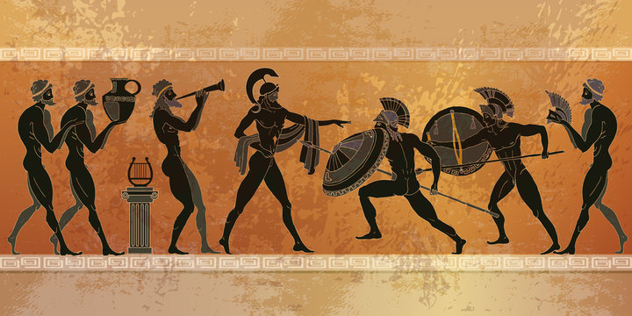
In the West, pottery is associated with vases from the Neolithic era, which were especially popular in ancient Greece. Today, some art historians associate the Greek pottery with the zenith of this art.

Slide 9
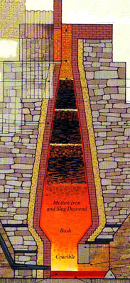
The first blast furnaces in Europe were created in the late 15th century to design that melt iron. At the time, they could heat up to 1,300 degrees Celsius. In later years, new ways were discovered to increase the heat resistance of materials and to use as many different materials as possible to work with a variety of products. It was the beginning of an industrial revolution, followed by many changes in both ceramics and other branches of art, science and technology.

Slide 10
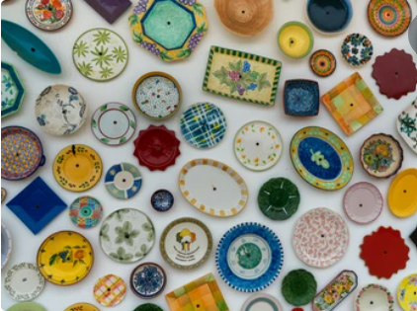
After World War II, pottery was used in many areas of technology, such as electronics or space exploration. Since then, the importance of pottery has only grown and it is already estimated that by 2023, the pottery sector will reach a market of almost $ 1.1 trillion.

Slide 11
What is the art of pottery?
Topic:
Check this video to get answers!
https://www.youtube.com/watch?v=t5IxnjNcwXA

Slide 12
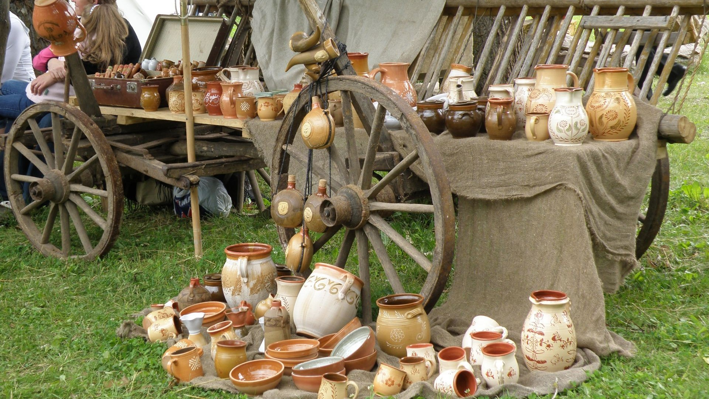
Ceramic products advantages
The versatility of clay as a material.
Variety of molding and decoration techniques, patterns and colors.
Easy maintenance.
Durability and resistance to chemicals.
Compactness, lightness and appearance.
Possibility to make many items at home.
Good price for both developer and consumer.

Slide 13
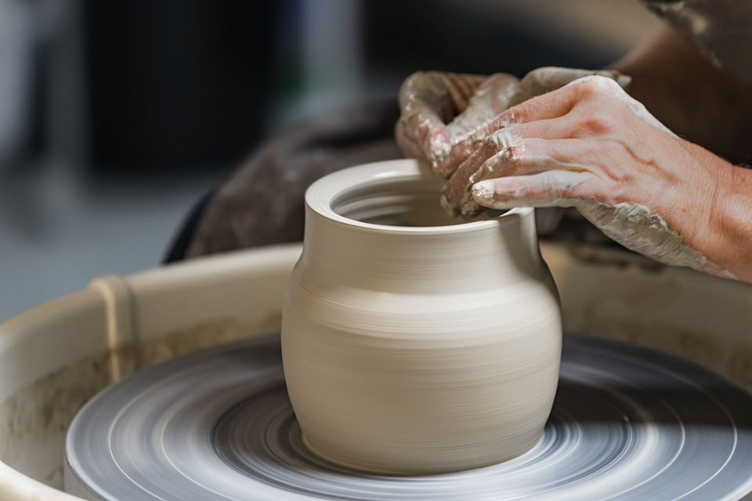
Main types of pottery
Porcelain.
Stoneware.
Earthenware.
How are these types similar and how are they different?

Slide 14
Porcelain
Porcelain ceramics are made by heating materials, generally kaolin clay, in a kiln to temperatures between 1000 and 1500 °C.
Porcelain is a very heat-resistant and strong material compared to other types of ceramics.
In China, porcelain is believed to have been invented during the Eastern Han Dynasty (I-II centuries). Porcelain production in Japan began in the 15th century, and in Europe in the 17th century. Disclosure of the technology to produce this material in China was tantamount to issuing a state.
Porcelain production began in Europe in 1708. The famous German scientist Ehrenfried Walther von Tschirnhaus and his student Johann Friedrich Böttger finally managed to extract a material similar to Chinese porcelain after long-term experiments. And in 1710, at the initiative of Emperor Augustus The Strong, the first European real porcelain factory in Europe opened its doors in Meissen, Germany.

Slide 15
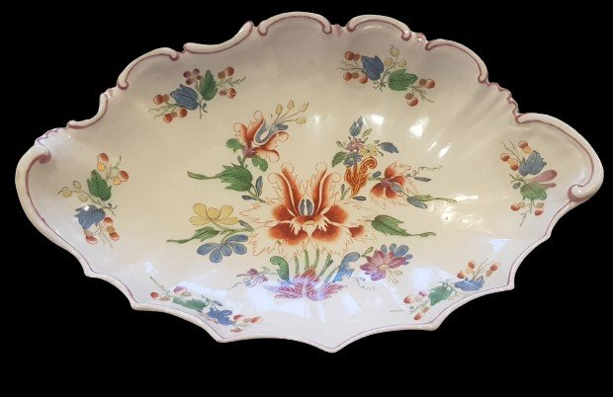
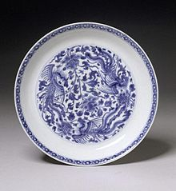
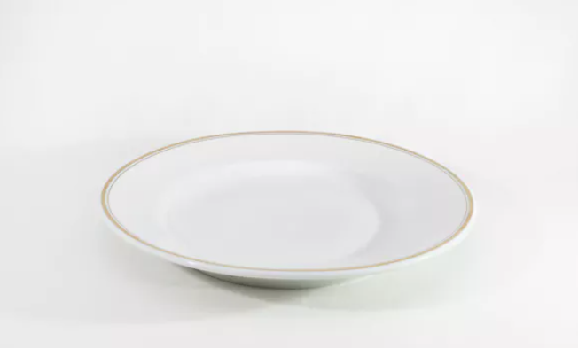
Porcelain types
True, or hard-paste, porcelain
Porcelain, produced by Europeans in the early 18th century, is classified as solid and is often referred to as Meissen. Containing 50% kaolin, 25% quartz, 25% feldspar and fired at extremely high temperatures of 1400-1500 °C, hard porcelain is resistant to temperature changes, extraordinary sound and strength. Meissen porcelain is considered the highest type of porcelain and is often rewarded with epithets such as aristocratic or royal. Porcelain of this kind is an integral part of the interiors of luxury hotels, and restaurants, as well as decorating the homes of private collectors.

Slide 16
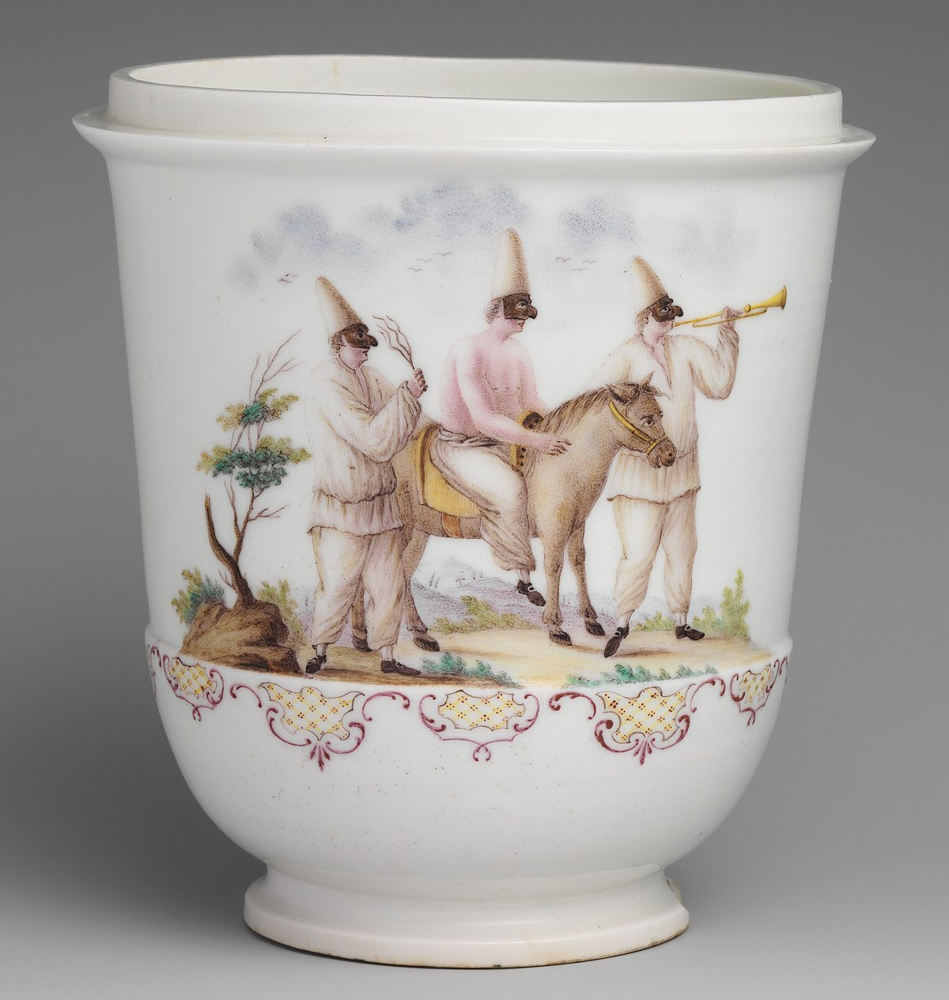
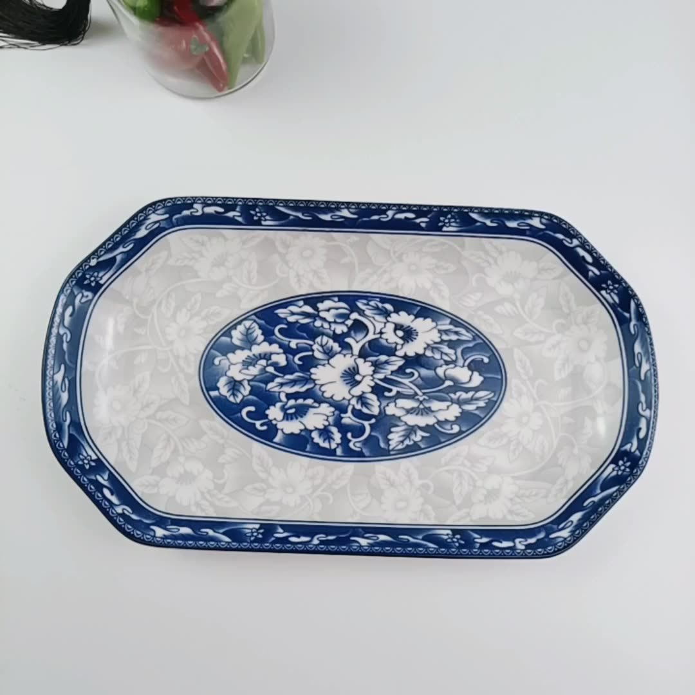
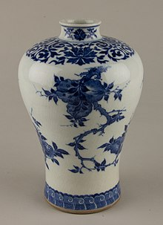
Porcelain types
Artificial, or soft-paste, porcelain
Soft porcelain produced in China differs from hard European porcelain in its lower proportion of kaolin (25-40%), its significantly lower burning temperature, poor transparency, and resistance to temperature changes. Soft porcelain is sometimes called frit due to the impurities or frit contained in it: sand, celite, sea salt, alabaster, alum, gypsum, lead, glass. Soft porcelain is most suitable for decorative purposes, such as the production of vases or figurines, due to its luster and glass texture (hence the fragility). Hard porcelain, meanwhile, is widely used in the manufacture of tableware because of its durability.

Slide 17
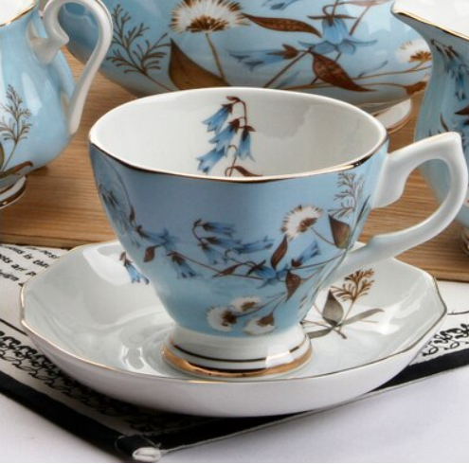
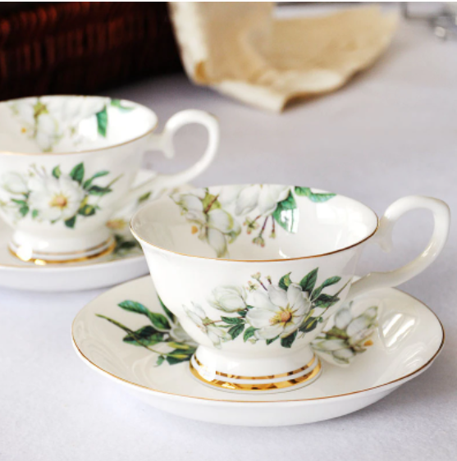
Porcelain types
Bone porcelain
The third type of porcelain is called bone and may contain 20-50% bone ash (as well as 20-35% kaolin, 20-45% feldspar). This calcium phosphate-rich material of animal origin gives porcelain extraordinary properties. The higher the amount of bone ash in porcelain, the whiter, lighter, more durable, thinner, and louder it becomes. The idea to supplement the composition of porcelain with ash from the bones of large bovine hips was born to the Englishman Thomas Frye in 1748.

Slide 18
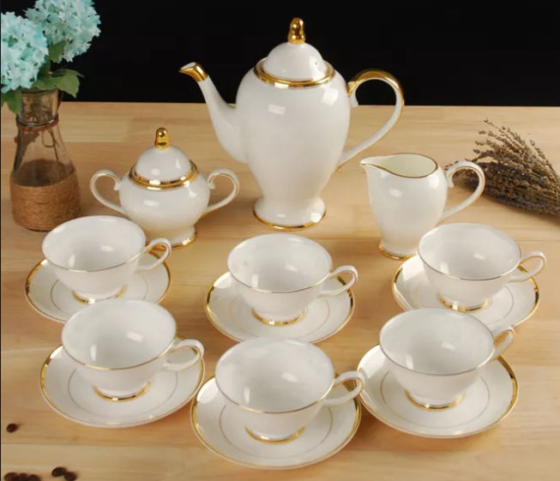
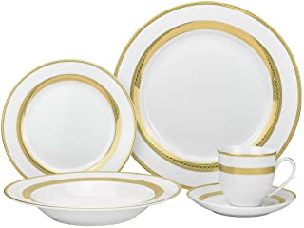
Porcelain types
Fine porcelain
Fine china is made from kaolin, a type of white clay. Porcelain is also made from kaolin, but the firing temperature is higher than that of fine china, making it more durable. The word porcelain derives from the Latin word porcella, which means seashell.

Slide 19
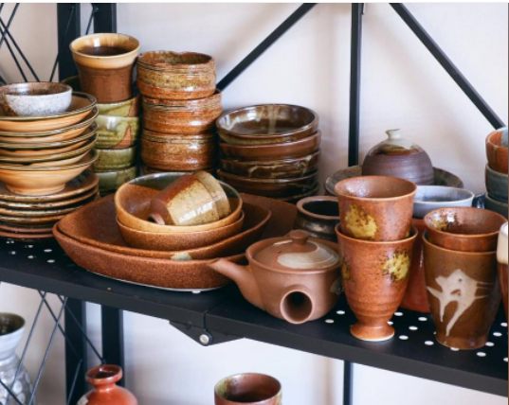
Stoneware
The stone powder contained in it is melted into a highly durable non-porous material at a temperature of 1300–2000 ºC. The dishes made from it are one of the most durable, heat-resistant, non-absorbent, suitable for use in ovens and microwaves. In such containers, the food stays refrigerated longer.
The first pottery was made in China during the Shang Dynasty. It first appeared in Germany in the 15th century. Later, in the seventeenth century, the potter began to produce salt-glazed pottery for the first time in English. The development followed in the eighteenth century, when a man named Josiah Wedgwood made black stone products or basalt and Jasper ware or white pottery.

Slide 20
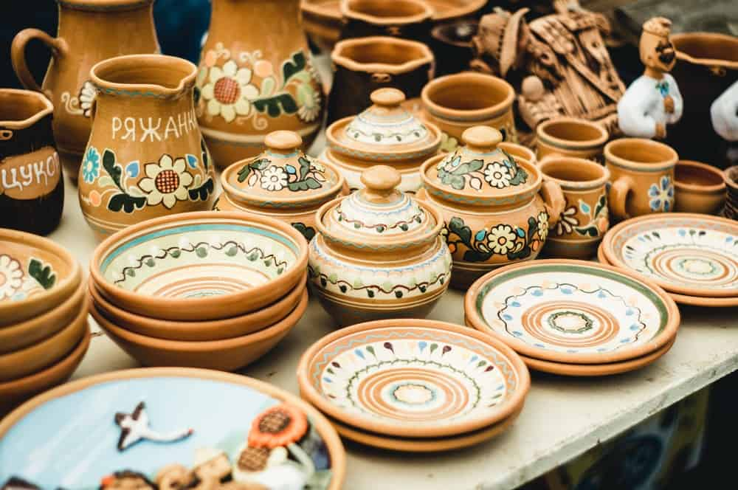
Earthware
Earthware products are practical, comfortable, suitable for storing food, inexpensive, natural, give comfort to the house, and kitchen, but quite unstable, more suitable for country-style wood-decorated homes. They are fired at a lower temperature (850–1000 ºC) than other ceramics. If the edges of the clay cup or plate crumble very quickly, the clay was probably burned at too low a temperature. Clay pots are usually covered with a transparent glaze, so the clay retains its natural color.

Slide 21
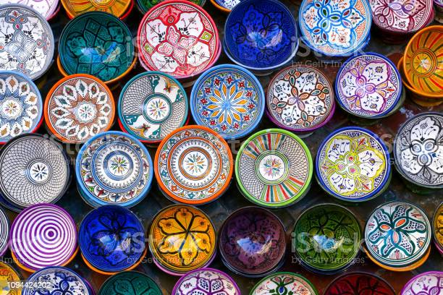
Other types of pottery
Glass ceramics.
Carbon.
Fired bricks.
Silicon.
Bioceramic.
And many other types...

Slide 22
Is it possible to make pottery at home?
YES!

Slide 23
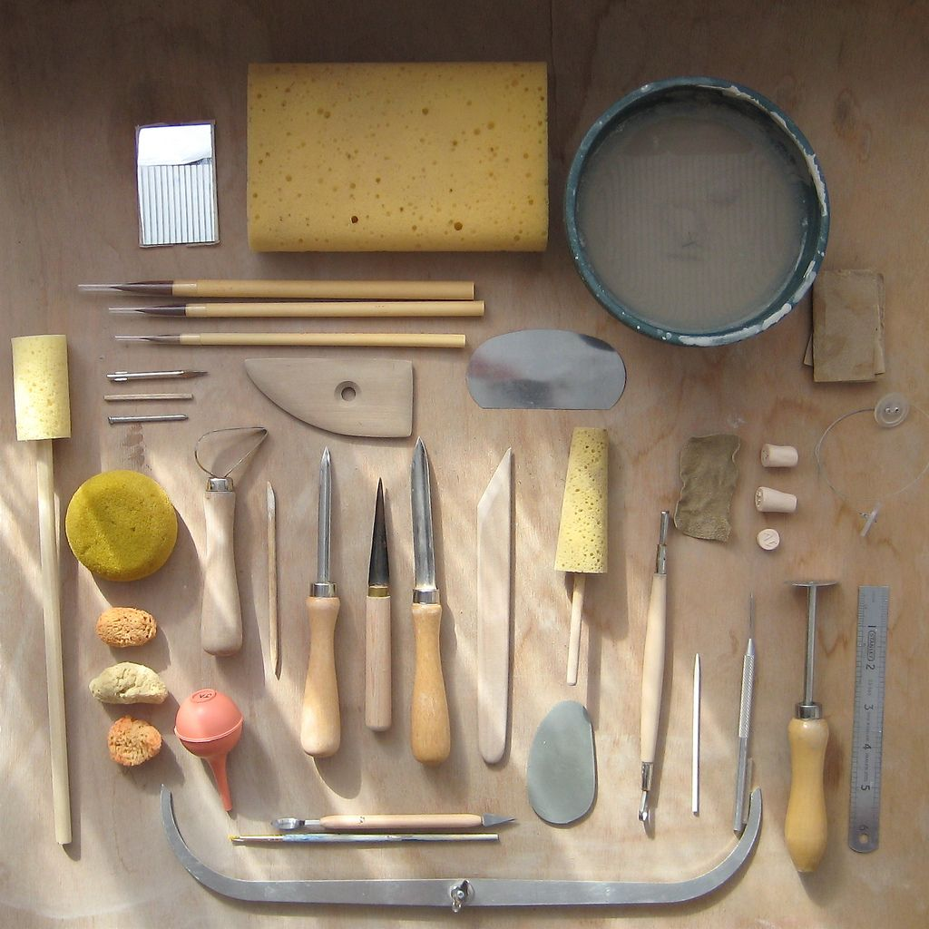
Topic: TECHNIQUES AND TOOLS
Necessary tools for the practical activity:
Clay (the best stoneware because it's the easiest to work with for beginners; however, those with skills can choose earthenware or porcelain).
Kiln (selected according to the type of clay due to different temperatures for the development of ceramic products).
Pottery wheel (selected according to the possibilities and planned products).

Slide 24
Additional tools for the practical activity:
• Needles (for piercing clay, measuring thickness, carving and trimming).
• Cutter wire (for dividing large blocks of clay into chunks).
• Ribbon tools (especially useful when shaping clay by hand – used for trimming and carving).
• Scrappers (for final smoothing of the pieces).
• Fettling knives (for separating molds, trim, pierce, carve, sculpt and cut chunks of clay).
• Chamois cloth (for compressing the clay and creating smooth surfaces).
• Calipers (for measuring the distance between two opposite sides).
• Brushes (for glazing or applying slip).
• Sponges (for shaping and cleaning surfaces).
• Glaze and other decorating materials (for creating the final look of the work).

Slide 25
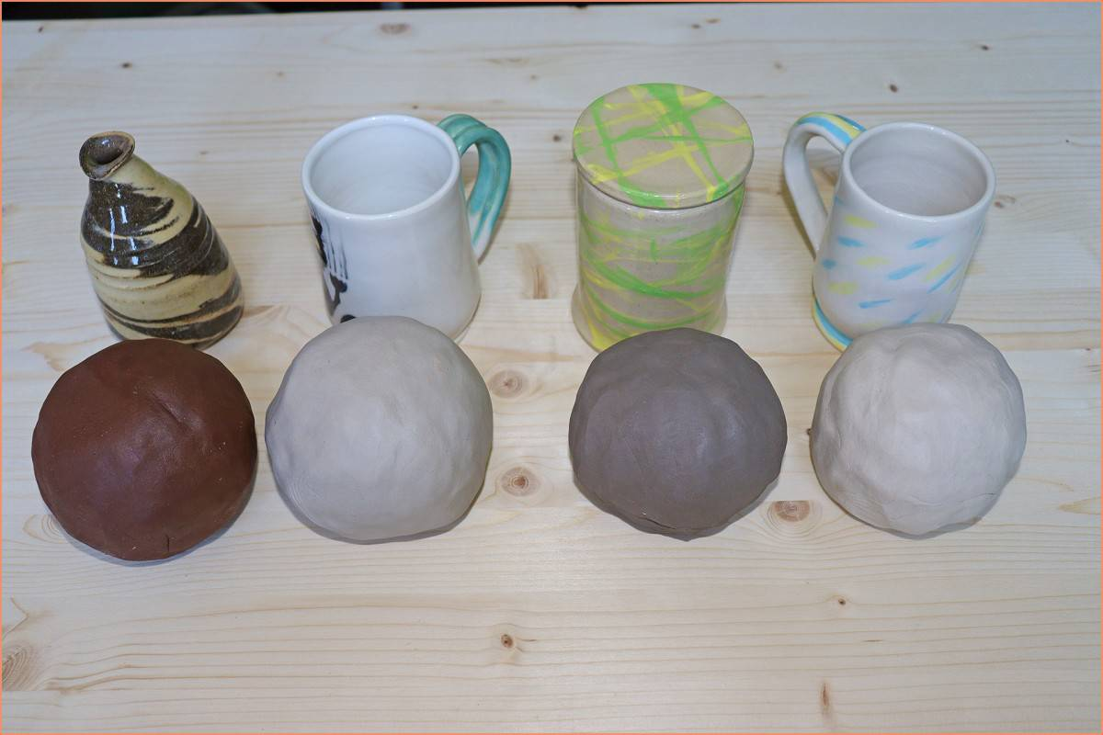
Types of clay:
Earthenware clay.
Stoneware clay.
Ball clay.
Porcelain.

Slide 26
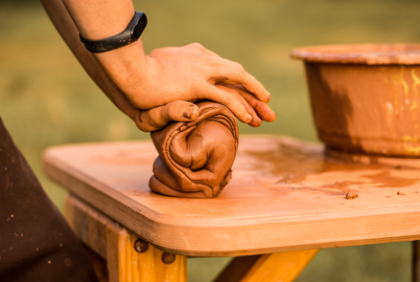

Slide 27
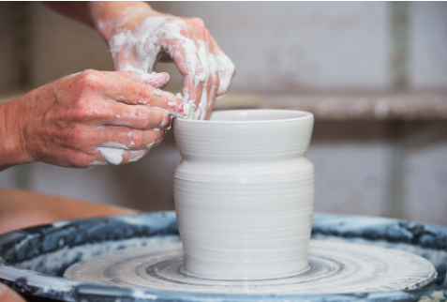

Slide 28
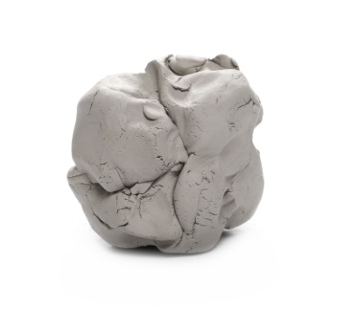

Slide 29
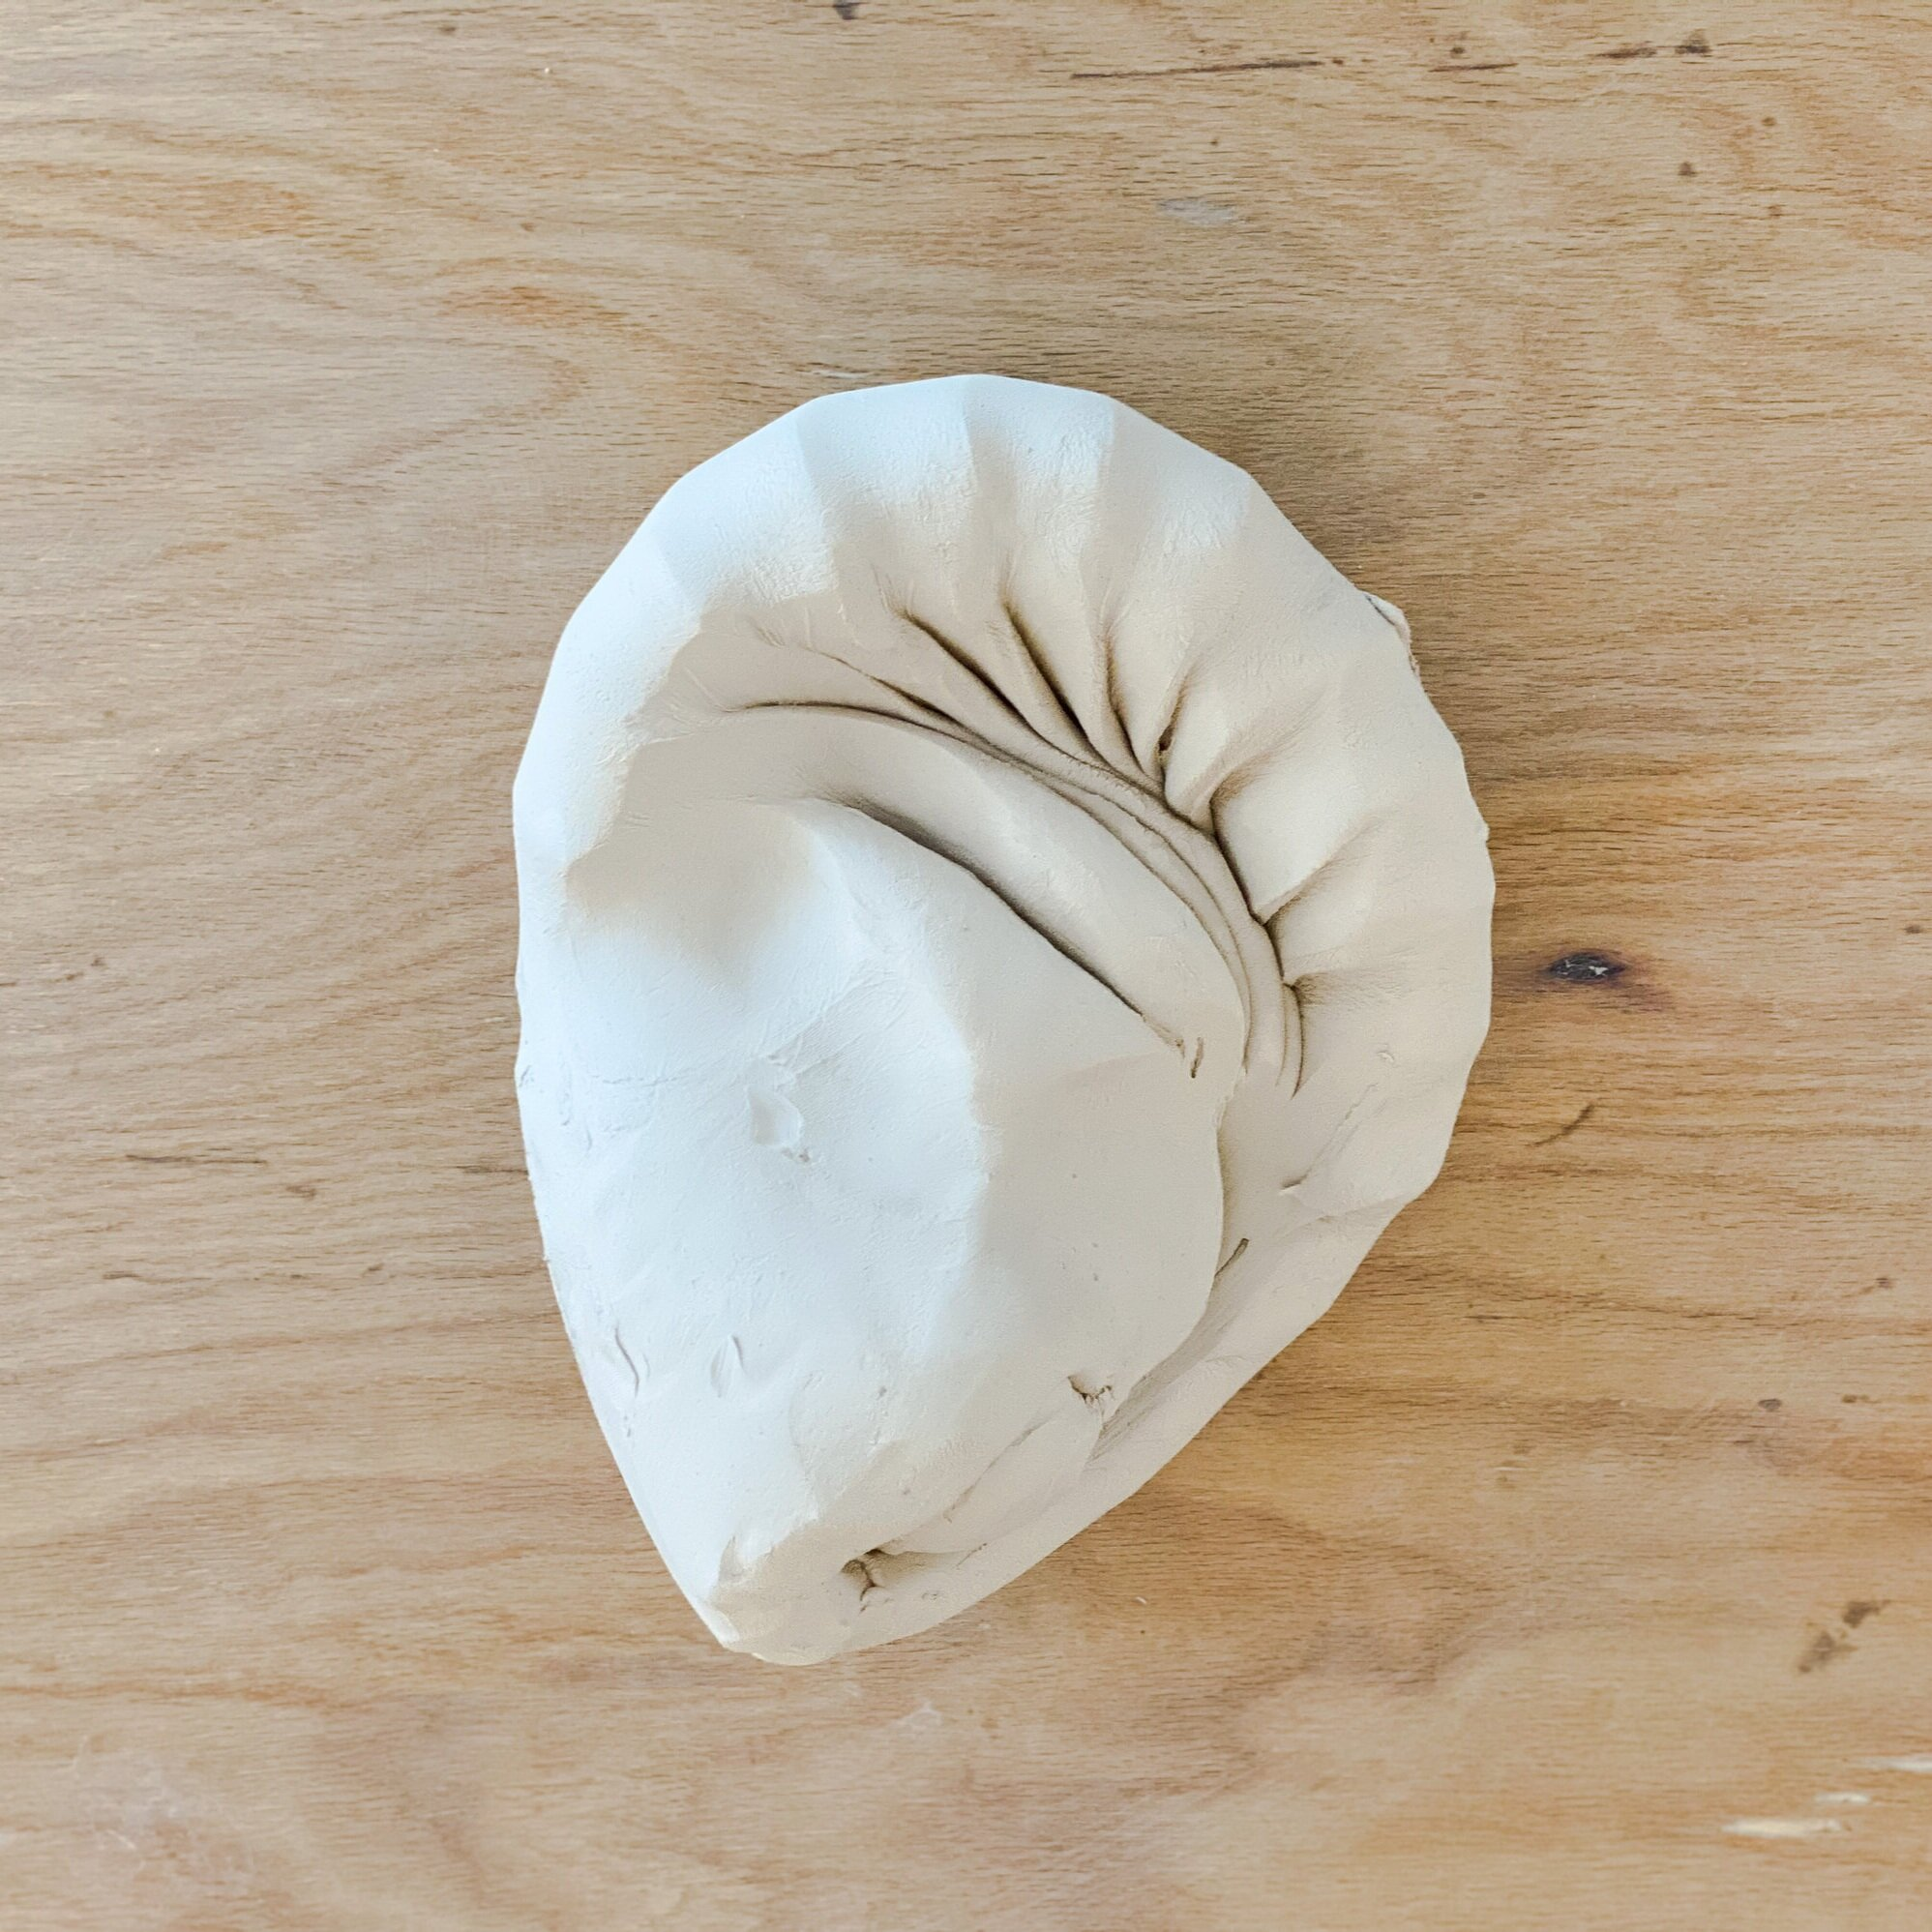

Slide 30
Learn more about pottery tools!
https://www.youtube.com/watch?v=4Lrenmts9Sk

Slide 31
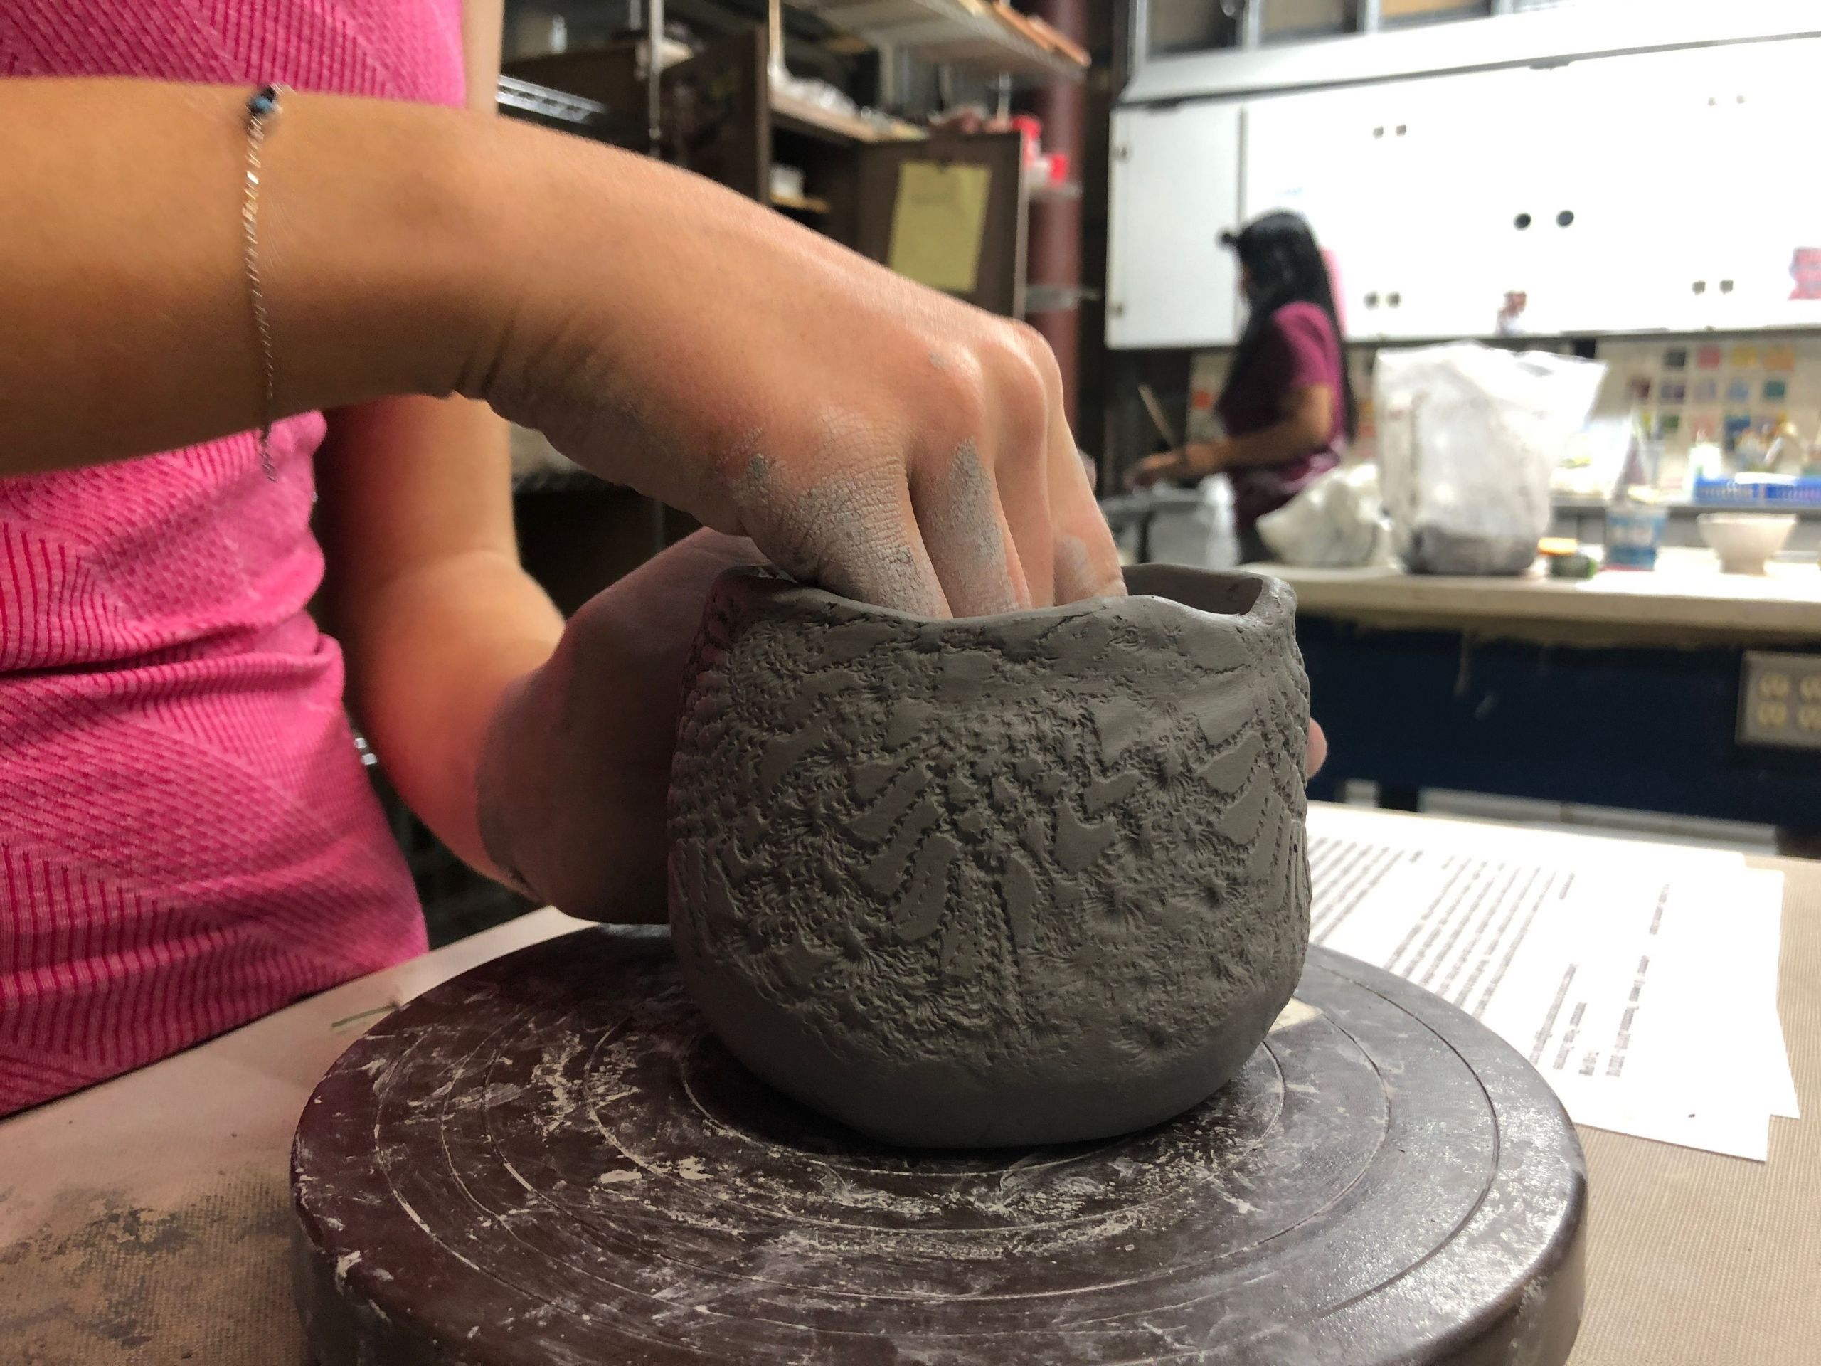
Handbuilding is a great choice for beginners!

Slide 32
HANDBUILDING TECHNIQUES
Handbuilding is a ceramics technique that allows you to create forms with clay and your hands, without using a throwing wheel. Before ceramicists invented the wheel, handbuilding was the only way they could create functional and artistic ceramic forms. The oldest known ceramic artifact was handbuilt and is dated as early as 28,000 BCE. All you need to get started are your clay, your hands, and a few simple tools.
Handbuilding is a ceramics technique that allows you to create forms with clay and your hands, without using a throwing wheel. Before ceramicists invented the wheel, handbuilding was the only way they could create functional and artistic ceramic forms. The oldest known ceramic artifact was handbuilt and is dated as early as 28,000 BCE. All you need to get started are your clay, your hands, and a few simple tools.
Techniques:
Pinching pots.
Coiling.
Slab pots.

Slide 33
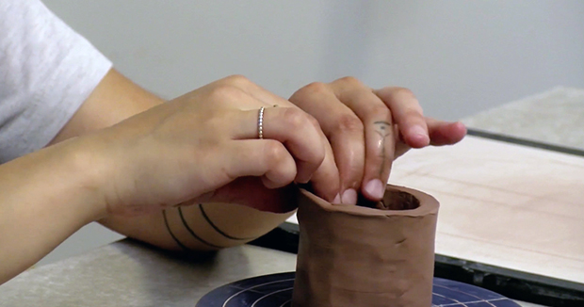
PINCHING POTS
A pinch pot is a simple form of hand-made pottery produced from ancient times to the present. The pinching method is to create pottery that can be ornamental or functional, and has been widely employed across culture. The method used is to simply have a lob of clay, then pinch it to the shape desired.
Pinch pots are the simplest and fastest way of making pottery, simply by pinching the clay into shape by using thumb and fingers. Simple clay vessels such as bowls and cups of various sizes can be formed and shaped by hand using a methodical pinching process in which the clay walls are thinned by pinching them with thumb and forefinger. It is a basic pot making method often taught to young children or beginners.
The process begins with a ball of clay. Thumbs are pushed into the center, and then rudimentary walls are created by pinching and turning the pot. The pot is then pushed on a flat surface to create a flat surface, thereby creating the base. A base can be made by rolling three coils and pressing them together, and then onto the bottom of the pot. Pinched, compressed clay may also be used as a base for building coil pots. The base of the pot is less prone to cracking when formed this way.

Slide 34
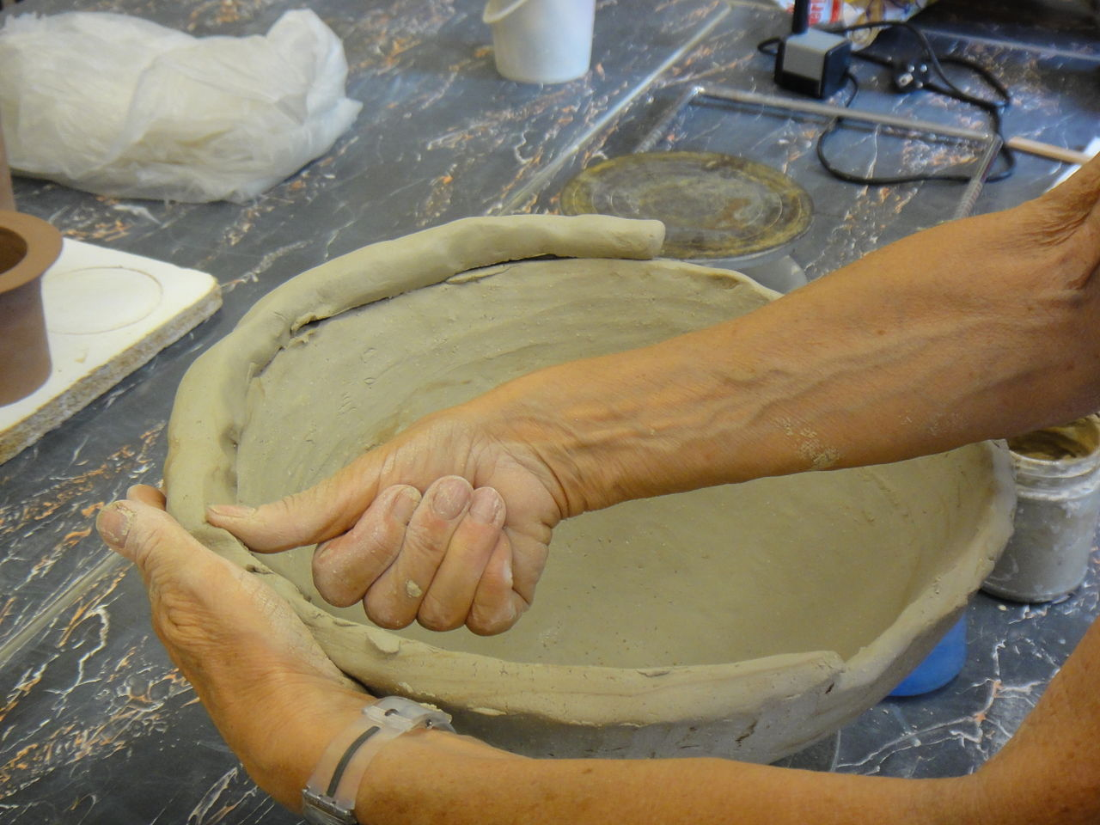
COILING
Coiling is a method of creating pottery. It has been used to shape clay into vessels for many thousands of years. It is found across the cultures of the world, including Africa, Greece, China, and Native American cultures of New Mexico. Using the coiling technique, it is possible to build thicker or taller walled vessels, which may not have been possible using earlier methods. The technique permits control of the walls as they are built up and allows building on top of the walls to make the vessel look bigger and bulge outward or narrow inward with less danger of collapsing. To do this, the potter takes a pliable material (usually clay) then rolls it until it forms a coil, or long pliable cylinder. By placing one coil on top of another, different shapes can be formed. As this is done while the clay is still fresh and soft, individual coils can be joined seamlessly with simple pressure, rather than by scoring and/or applying slip to the surface. Optionally, coils may only be joined internally or externally, leaving them visible on the other side as an aesthetic choice.

Slide 35
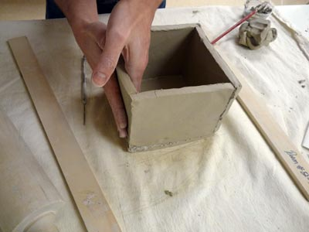
SLAB POTS
A slab pot is formed by joining flat slabs of clay together after they have been processed through a slab roller. Slab rollers, which are basically industrial-sized rolling pins, are a great tool that allows for quick and efficient production of clay slabs used.
The slab technique starts with smooth slabs of clay that are then formed around molds or shaped by hand. Although it can be used to create many of the same shapes that are achievable on a wheel, slab building also allows the potter to create more angular shapes that are more challenging to make on a wheel.

Slide 36
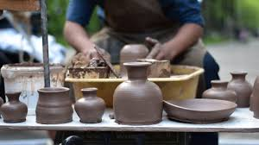
Beginner pottery techniques – learning online
Clay flicks watch and learn: https://ceramicartsnetwork.org/clayflicks/technique-levels/beginner-pottery-techniques
Pottery on the Wheel: http://www.pottery-on-the-wheel.com/
Timsee Clay Channel: https://www.youtube.com/playlist?list=PL5F345871510B9B05
….

Slide 37
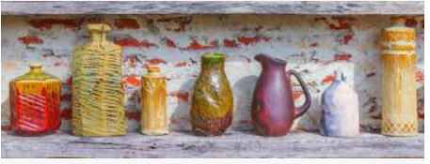
Ceramic decorating techniques
Choose your favorite decorating technique: https://ceramicartsnetwork.org/daily/ceramic-decorating-techniques

Slide 38
Topic: THE RIGHT CREATIVE ENVIRONMENT
Tips for creating a workplace for working with ceramics:
Choose where you will set up the studio based on your ability to combine hobbies and other activities in the facilities available.
Make sure there is enough light and the right temperature in the place you choose.
Don’t buy all the tools you can at once without underestimating what you really need and what your skills are.
Make sure you have enough space to store all your tools and finished work, this may require separate shelves.
Decide as early as possible what you are going to do and what techniques you will use.

Slide 39
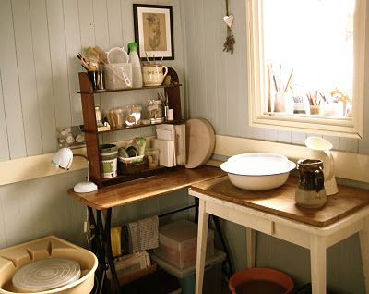
Is it possible to set up a pottery studio at home with very little space?
YES!

Slide 40
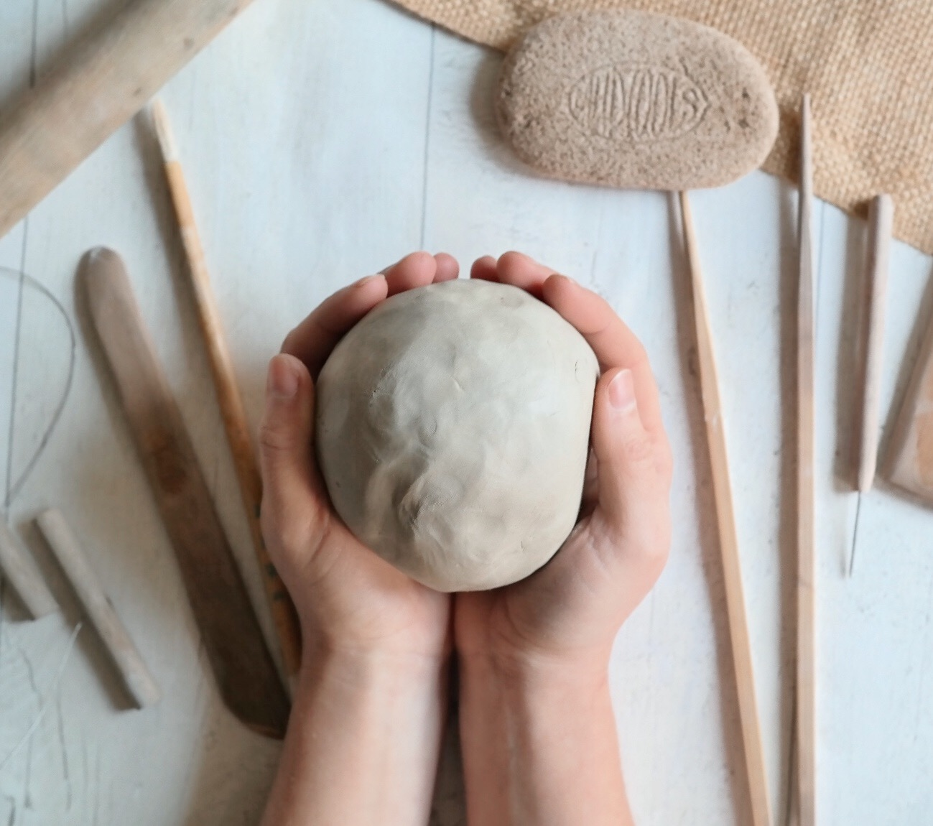
Tools and equipment for the beginners
Necessary tools:
Clay (the best stoneware because it's the easiest to work with for beginners; however, those with skills can choose earthenware or porcelain).
Needle tool (for throwing and scoring).
Wire tool (to cut clay).
Wooden bowl rib (for shaping bowls).
Sponge (for working with the clay).
Clean up tool (for trimming and cutting the clay).
…

Slide 41
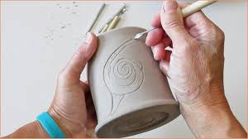
And some other things from the additional tools section…
For example, that could be:
Simple carving tools (for carving designs).
Throwing stick (for shaping).
Calipers (for making lids fit).

Slide 42
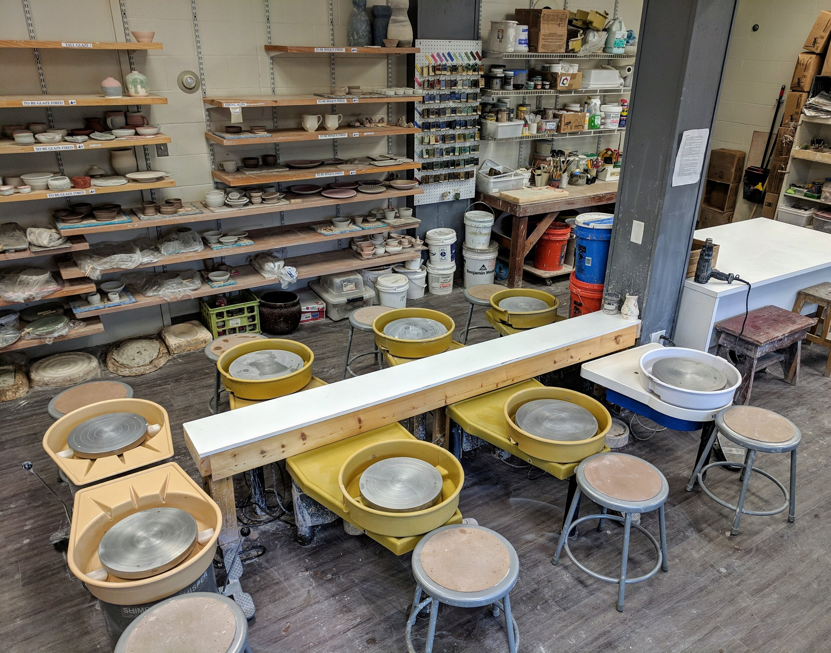
Equipment for the pottery studio
Wheel.
WorkTable.
Storage Shelf.
Damp Room.
Kilns.
Glaze area.
Tool/Bat Storage.
Clay Storage.
All choices depend on the goals set, the skills acquired and the opportunities

Slide 43
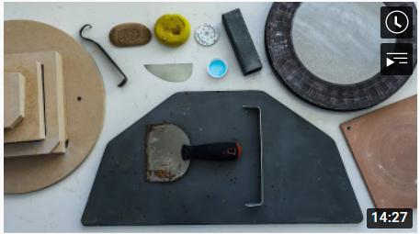
Still have some questions about pottery tools? Check out this video!
https://www.youtube.com/watch?v=i5e4HN-zmOM

Slide 44
Safety information for ceramics
All clay materials are dangerous for your respiratory system. Some glaze materials are hazardous, too.
It is a must to know what kind of materials are used and how to use them properly.
Workspace is not for eating, drinking or smoking.
Discarding unused toxic glaze materials must not pollute the environment.
All the equipment has to installed and used in a proper manner.

Slide 45
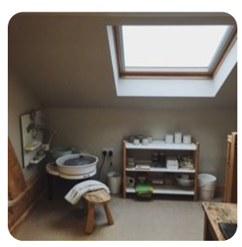
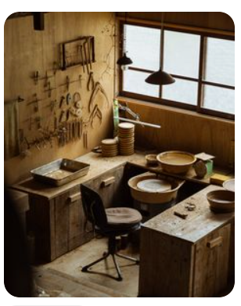
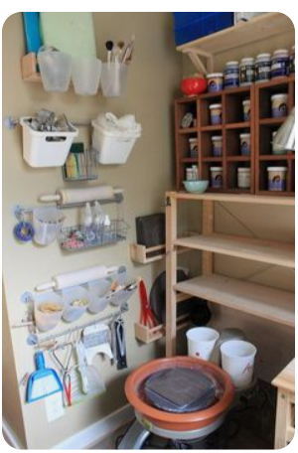
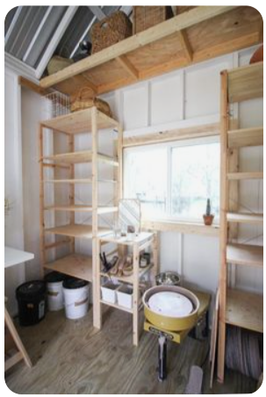
How to set up a cozy pottery workshop at home? Several ideas
And many more ideas: https://www.pinterest.com/sbullard08/ceramic-workspace/

Slide 46
How to reduce your ecological impact? (1)
1. Choose renewable energy sources and use energy properly
Electricity is one of the key elements in your work. For example, it is needed for electric kilns, so it is important to use energy responsibly. Make sure you use the kiln purposefully every time and do not waste energy.
2. Reuse unfired clay
Even small pieces of clay left over after work can be reused. Wet clay can be dried and become suitable again for molding other things in consistency. You’ll be amazed at how many interesting pieces can be made from the rest of the clay.

Slide 47
How to reduce your ecological impact? (2)
3. Reduce waste
Reuse tools, materials, and utensils such as glazes or brushes. Find out about the properties of all the materials used and make sure you choose the right amount for the job. Keep in mind that even waste can prompt creative solutions.
4. Recycle waste
Take a close look at what you use in your workshop. Find out the components of materials and tools, and when you plan to dispose of them, do so properly. Even small workshops generate a lot of waste, but that doesn’t mean it’s impossible to protect nature from pollution.

Slide 48
How to reduce your ecological impact? (3)
5. Avoid toxic substances and materials
Today, the market offers many innovative and green solutions that are worth taking advantage of. Good substitutes for toxic substances can be found both online and at local art stores. For example, iron oxide is the most widely available and non-toxic coloring oxide and gives colors ranging from amber and rust red to black.
6. Reuse shards from broken pots
Sometimes it happens that one or the other pot breaks, but it is not worth removing all the debris at once. Evaluate whether anything can be reused to make something else. Where possible, it is worth making creative decisions.

Slide 49
How to reduce your ecological impact? (4)
7. Use waste materials
You can start using wood ash from your wood burner or fireplace. It can be soaked in water, sifted, then combined with clay and feldspar to make a glaze. Wood ash can be really colorful and necessary for a piece.
8. Choose an electric kiln instead of a gas kiln
Kiln is one of the main tools of work, so it is important to choose it responsibly. While gas kilns are still popular, it’s worth taking a look at electric kilns, which are much more environmentally friendly and just as easy to use.

Slide 50
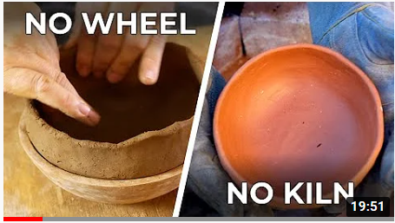
Did you know that pottery at home can be anything, even without the most important tools?
Find out more: https://www.youtube.com/watch?v=VaX1iOyKsB0

Slide 51
QUIZ TIME
First human-made pottery was found in:
A Asia
B Europe
C Africa

Slide 52
First human-made pottery was found in:
A Asia
B Europe
C Africa
The Venus of Dolní Věstonice, the 29,000-year old ceramic statuette of a woman that was originally discovered in 1925 at the Paleolithic site south of Brno, in the Czech Republic. It is considered as first human-made pottery.

Slide 53
Which one of these is not a type of pottery?
A Stoneware
B Bone porcelain
C Cubism

Slide 54
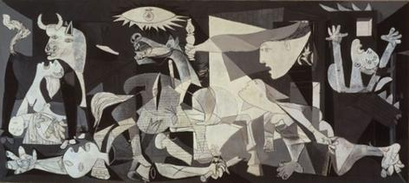
Question with 3 options as answers and only one correct answer
Reply in Correct answer:
“ Your Answer is correct and explanation why “
Reply in Wrong Answers:
“ Your answer is wrong! The correct answer is….. And why “
You can create maximum 6 quizzes
Which one of these is not a type of pottery?
A Stoneware
B Bone porcelain
C Cubism
Cubism is an early-20th-century avant-garde art movement that revolutionized European painting and sculpture, and inspired related movements in music, literature and architecture.
Pablo Picasso, “Guernica”, 1937.

Slide 55
Question with 3 options as answers and only one correct answer
Reply in Correct answer:
“ Your Answer is correct and explanation why “
Reply in Wrong Answers:
“ Your answer is wrong! The correct answer is….. And why “
You can create maximum 6 quizzes
Country of origin of porcelain is:
A China
B Germany
C Australia

Slide 56
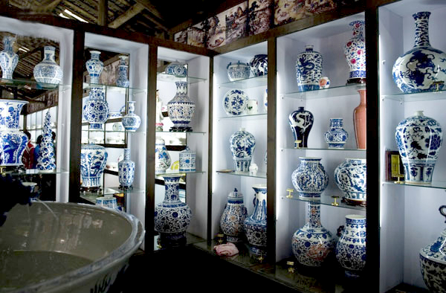
Question with 3 options as answers and only one correct answer
Reply in Correct answer:
“ Your Answer is correct and explanation why “
Reply in Wrong Answers:
“ Your answer is wrong! The correct answer is….. And why “
You can create maximum 6 quizzes
Country of origin of porcelain is:
A China
B Germany
C Australia
The technology of Chinese porcelain production was developed at the beginning of the rule of the Tang Dynasty (618–907) (according to other data - in the 6th century) with improvements from the 4th century. pr. 3 BC pr. Kr. Stone mass cookware made in China. The Porcelain Capital is a city of Jingdezhen in China.

Slide 57
Question with 3 options as answers and only one correct answer
Reply in Correct answer:
“ Your Answer is correct and explanation why “
Reply in Wrong Answers:
“ Your answer is wrong! The correct answer is….. And why “
You can create maximum 6 quizzes
Which type of clay is recommended for beginners?
A Porcelain
B Ball clay
C Stoneware

Slide 58
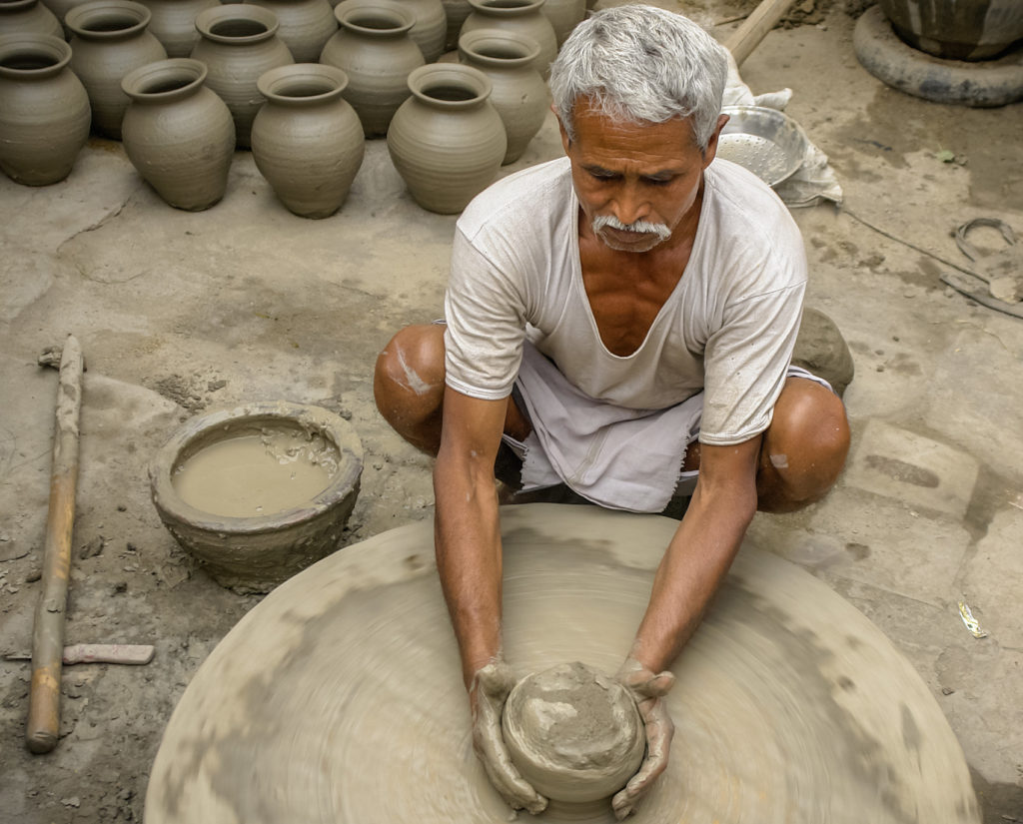
Question with 3 options as answers and only one correct answer
Reply in Correct answer:
“ Your Answer is correct and explanation why “
Reply in Wrong Answers:
“ Your answer is wrong! The correct answer is….. And why “
You can create maximum 6 quizzes
Which type of clay is recommended for beginners?
A Porcelain
B Ball clay
C Stoneware
Stoneware clay with a fine grog is best for a beginner choosing clay. This is because it is cooperative and does what the potter wants. And it holds its form once shaped. It is versatile and can be used for throwing, hand-building and modeling.

Slide 59
SUMMARY
This section briefly presents the history of ceramics, the main types of ceramics that reveal the artistic and practical versatility of this art.
Both the most necessary materials and tools and techniques are presented. Emphasis is placed on what is most relevant to beginners. Finally, tips on how to create the right work environment at home are provided.

Slide 60
Resources
17 Types of Ceramics - Simplicable. (n.d.). Retrieved May 22, 2022, from https://simplicable.com/new/ceramics
A Brief History of Ceramics & Urns – Pulvis Art Urns. (n.d.). Retrieved May 22, 2022, from https://www.pulvisurns.com/blogs/news/a-brief-history-of-ceramics
Beginner Pottery Techniques. (n.d.). Retrieved May 22, 2022, from https://ceramicartsnetwork.org/clayflicks/technique-levels/beginner-pottery-techniques
Ceramic Decorating Techniques. (n.d.). Retrieved May 22, 2022, from https://ceramicartsnetwork.org/daily/ceramic-decorating-techniques
Guide to Ceramics: Types, Materials, & How-To Learn. (n.d.). Retrieved May 22, 2022, from https://www.thecrucible.org/guides/ceramics/
Stoneware Clay - Materials - Materials Library - Institute of Making. (n.d.). Retrieved May 22, 2022, from https://www.instituteofmaking.org.uk/materials-library/material/stoneware-clay
Types of Clay - Earthenware, Stoneware, Ball, Fire and Kaolin clays. (n.d.). Retrieved May 22, 2022, from https://www.potteryandcraft.com/types-of-clay/
What are the Main Types of Ceramics? (n.d.). Retrieved May 22, 2022, from https://www.laurelandwolf.com/blogs/types-of-ceramics

Slide 61
Congratulations!
You just finalised the topic Theoretical introduction to the art of ceramics
Keep moving Forward!

Slide 62
1.2. GAINING BASIC PRACTICAL SKILLS.
This topic aims to and will cover the following:
Sub-Topic 1 Knowledge of materials
Sub-Topic 2 Creating simple forms
Sub-Topic 3 Basics of decorating

Slide 63
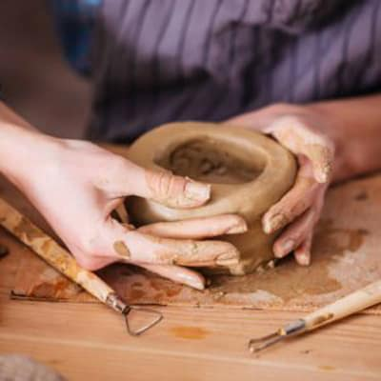
Topic: KNOWLEDGE OF MATERIALS
Starting work with clay
Some tips for the beginning:
No dry scraps are left lying around.
Adopt “clean as you go” method.
Avoid dry sweeping that will raise dust in the air.
Avoid using clay in carpeted spaces, as dust will be too difficult to remove.
Always mop the floor and wet sponge the surfaces after you are finished.

Slide 64
Clay types (1)
Oil-based clays are made from various combinations of oils, waxes and clay minerals. Because the oils do not evaporate as water would. Oil-based clays remain malleable even when left for long periods in dry environments. Articles made from oil-based clays cannot be fired, and therefore are not ceramics. Because the viscosity of oils decreases as temperature rises, the malleability is influenced by heating or cooling the clay. Oil-based clays can be heated, melted and then poured. Oil-based clay is not soluble in water. It can be re-used and so is a popular material for animation artists who need to bend and move their models. It is available in a multitude of colors and is non-toxic. However, some oil-based clay contains sulfur which prevents certain silicone mold rubbers from curing. In which case, non-sulfur oil-based clay should be substituted. Popular brands of oil-based clays include, DeMilano, Chavant and Roma.

Slide 65
Clay types (2)
Water-based clays - Originally developed for use in sculpting Disney's animatronics models, WED (Walter E. Disney) clay is an extremely versatile water-based clay with properties similar to many of today's most popular oil based clays. It's smooth, slow drying, extremely pliable, and works great for sculptors seeking a "fast sculpt" medium. WED clay is still commonly used by professionals in the entertainment industry for masks, modeling, mockup, and large scale sculptures. Like any water based clay, WED clay needs to be kept moist, preferably with a spray bottle or a damp towel. Saran wrap is also commonly used. It is not formulated to be fired.

Slide 66
Clay types (3)
Polymer clays –This is a type of modeling clay based on the polymer polyvinyl chloride (PVC) which can be hardened. Polymer clay is generally used for making arts and craft items, and is also used in commercial applications to make decorative parts. Art made from polymer clay can now be found in major museums. Polymer clay remains workable until cured generally from between 265 F (129 C) to 275 F (135 C) for 15-minutes per 1⁄4-inch (6.4 mm) of thickness. This temperature is significantly less than for mineral clays and can be achieved using a home oven. The clay does not shrink when cured. Brands of polymer clay include Fimo, Sculpey, Premo, Cernit, Formello, Modello,Du-Kit and Kato Polyclay. Polymer clay safety is the subject of concern specifically the long-term effects of exposure to certain phthalate plasticizers that have been classified a endocrine disruptors.

Slide 67
Clay types (4)
Dough clay – is a modeling clay, which may be edible or inedible whichresembles the product PlayDoh®, and is often, in fact, called playdough. Playdoughs are easily made at home in both cooked and uncooked versions, and are less expensive than some of the other types of clay. They are made of such ingredients as flour, cornstarch, cream of tartar, oil, and water. They can be colored when made, for example, with food coloring, or have color added after.

Slide 68
Clay types (5)
Paper clays sometimes referred to as fiberclay is any clay body to which processed cellulose fiber (paper being the most common) has been added. Earthenware, terra cotta, stoneware, porcelain and bone china clay bodies can be made into paper clay. The fiber increases the tensile strength of the dry clay and enables dry-to-dry and wet-to-dry joins. Commercial paper clays air-dry to a firm, lightweight sculpture, with minimal shrinking during the drying process. Paper clay can be used as an unfired body in craft and doll making. It is used in ceramic art studios as sculptural and functional studio pottery. Commercially paper clay is used to retard warping in clay, reduce weight of clay objects, and to lessen the cost of producing clay objects by replacing part of the clay with paper fibers which costs less. This is a common practice in the brick making industry.

Slide 69
Clay types (6)
Ceramic clays are classified into five classes; earthenware clays, stoneware clays, ball clays, fire clays and porcelain clays. The three most commonly used ceramic clays are earthenware clay bodies, mid-fire stoneware clay bodies, and high-fire stoneware clay bodies. All three are available commercially in moist, ready-to-use form. Clay bodies can also be produced by mixing dry clays and additives with water to create your own desired clay body.

Slide 70
Ceramic clays (1)
Eartheware clays - were some of the earliest clays used by potters, and it is the most common type of clay. The clays are easily worked and can be sticky. Earthenware clays contain iron and other mineral impurities which cause the clay to reach optimum hardness at between 950°C and 1100°C.
Stoneware clays - are plastic and are often grey when moist. Their fired colors range through light grey and buff, to medium grey and brown. Fired colors are greatly affected by the type of firing.

Slide 71
Ceramic clays (2)
Ball clays - cannot be used by themselves due to their excessive shrinkage during drying and firing. They are extremely useful, however, when added to other clays to increase workability and plasticity.
Fire clays - vary widely in their characteristics. The hallmark is their high firing range. They mature at about 1500°C. Although relatively free from mineral impurities, they tend to have spots of iron which lend a speckled appearance once fired.
Kaolin clays - due to their mineral purity, kaolin clays are used for porcelain. Although kaolin clays do have some range in color, they are all very light in color. While moist, they will be light grey and will fire in the range between a very light grey or buff, to near-white and white.

Slide 72
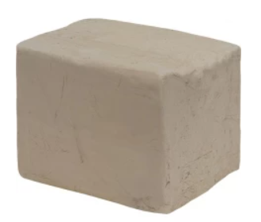
Stoneware clay is recommended for the beginners
Is more durable and chip-resistant than earthenware and which makes it more popular in its use for dinnerware and mugs.
You can make almost anything with stoneware depending on how much sand or grog is added.
Their colors range from white, buff (sand), brown, and different shades of gray.
It is a lower quality clay than porcelain but more popular because of its durability and value.
Stoneware has two firing temperatures: Mid fire range which is typically Cone 1186 ℃ to Cone 1222 ℃. And High fire which is usually Cone 1285 ℃.
You should not mix different types of clay.

Slide 73
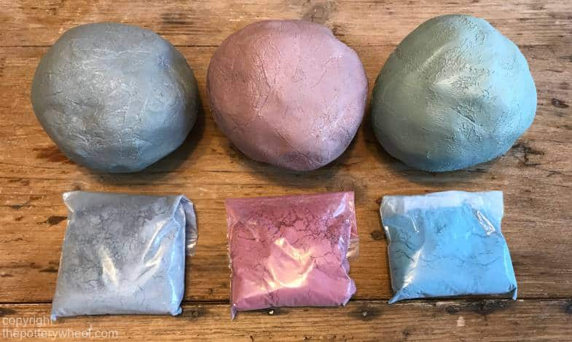
What colors to choose?
White is a nice choice if you want your glaze colors to pop. The color tends to turn out more vibrant. Clean up is also better because white clay does not stain your clothes or anything else for that matter.
Sand/ Buff color is very close to white when it comes to glazes being vibrant because there’s not much of a difference. When buff clay is wet it looks pretty dark, once it is bisque it has a nice light buff color that doesn’t interfere with the glaze colors.
Red is great if you like working with a deep, rich color. Red is beautiful with a clear matte, satin, or glossy glaze over it. Darker clays will stain your clothes because of the iron content in them.
Black clay is a stunning color that goes beautifully with light or white underglazes or all by its self with a clear glaze.

Slide 74
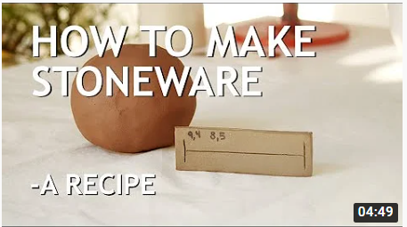
Make your own clay!
https://www.youtube.com/watch?v=-cu1wZhsWjc

Slide 75
Topic: CREATING SIMPLE FORMS
Some ideas for working with clay:
Clay Flower Pot.
Clay Flower Vase.
Clay Coffee Mug.
Clay Wall Art.
Clay Pencil Holder.
Clay Bowl / Clay Plate.
Clay Soap Dish.
Clay Paperweight.

Slide 76
Make something yourself
Learn more: https://www.thesprucecrafts.com/basic-hand-building-techniques-2745928

Slide 77
Topic: BASICS OF DECORATING
Resources for the information on decorating tools and techniques
https://www.thesprucecrafts.com/decorating-basics-for-potters-2745843
https://ceramicartsnetwork.org/daily/ceramic-decorating-tools

Slide 78
SUMMARY
This section presents clay types in more detail. Depending on the clay chosen and the tools available, ideas for various products and decoration techniques are offered. Participants are encouraged to choose the tools and methods that are more appropriate and enjoyable for them to implement the ideas.
Whenever possible, participants engage in practical tasks selected by the facilitator.

Slide 79
Resources
10 Simple & Easy Pottery Ideas And Projects For Beginners – The Beginning Artist. (n.d.). Retrieved May 22, 2022, from https://www.thebeginningartist.com/pottery-ideas-for-beginners/
12 Top Tips to Start a Pottery Hobby – A Beginners Guide. (n.d.). Retrieved May 22, 2022, from https://thepotterywheel.com/how-to-start-a-pottery-hobby/
Classifications of Clay Types - ArtMolds. (n.d.). Retrieved May 22, 2022, from https://www.artmolds.com/clay-types
Decorating Basics in Pottery. (n.d.). Retrieved May 22, 2022, from https://www.thesprucecrafts.com/decorating-basics-for-potters-2745843
Learn Some Basic Pottery Techniques | Cindy Couling - Mixed Media Artist. (n.d.). Retrieved May 22, 2022, from https://www.couling.com/basic-pottery-techniques/

Slide 80
Congratulations!
You just finalised the topic Gaining basic practical skills
Keep moving Forward!

Slide 81
1.3. CREATING AN ART PROJECT.
This topic aims to learn to self-create an artpiece and will cover the following:
Sub-Topic 1 Creating an idea
Sub-Topic 2 Creation of a work
Sub-Topic 3 Dissemination and sale of the work

Slide 82
Topic: CREATING AN IDEA
Things to think about before you begin:
Purpose;
Resources (financial, logistical, space and time, etc.);
Skills available;
Nature of activity (independently, attending group classes, hiring personal teachers).

Slide 83
Brainstorming
Creating the plan to begin

Slide 84
What am I aiming for;
What it takes to achieve;
What I already have and what I lack;
How can I get what is missing;
How do I imagine the final product;
Who is the product for?
Is this my hobby, side job or full-time job?..

Slide 85
Get inspired!
https://www.pinterest.com/mkmpotterytools/handmade-pottery/

Slide 86
How to become an artist?
Establish a routine to practice your skills.
Choose your niche.
Get advice from professionals.
Explore your style.
Create your portfolio.
Market yourself and your work.

Slide 87
Topic: CREATION OF A WORK
How to plan your work in the pottery studio
Create a making list of items you would like to create, sale and exhibit.
List the steps for each of the objects you need to make.
Estimate the time needed for each step.
Choose a path based on your available work session.
Order the steps and add making times.
Determine how many working sessions you will need to complete pieces planned for the sale or exhibition.

Slide 88
Decide what you want to do
The variety of tools, techniques, and shapes is extremely wide, so it’s important to understand which products will be the focus.

Slide 89
Topic: DISSEMINATION AND SALE OF THE WORK
How to prepare for the first exhibition (1)
Know the Audience.
Consider the Time-frame.
Determine the Type of Your Art Exhibition.
Prepare Your Artworks.
Take Pictures of Your Arts.
Price Your Artworks.
Plan How To Maximize Your Space.
Think About the Transportation of Your Artworks.
Consider How You Are Going to Document the Event.
Set-up a Marketing Plan.

Slide 90
How to prepare for the first exhibition (2)
Think How You Are Going to Process Sales and Shipping.
Double Check Your Exhibition Checklist.
Ask Help from Your Friends or Hire an Assistant.
Send E-mails Before, During, and After the Show.
Offer Refreshments.
Interact With The Public.
Prepare an Explanation for Your Artworks.
Suit-up for the Show.

Slide 91
How to make a living selling pottery?
Motivate yourself and build confidence.
Gain experience.
Strategize your business plan.
Set up a workspace.
Create pottery pieces.
Market your brand.
Sell your pottery and grow your business.

Slide 92
Learn more about selling ceramics: https://www.youtube.com/watch?v=CEyWDoRHA6M

Slide 93
The Internet is a great medium for both learning new skills and realizing ideas

Slide 94
SUMMARY
This section provides participants with tips on how to generate ideas for potters at home. The stages from the conception of an idea to its implementation and publicity - presentation and sale are briefly reviewed. It provides guidelines that the learner can follow without forgetting that the most important decisions will be made by him / herself.

Slide 95
Resources
About to Exhibit Your Art for the First Time? Here are 3 Important Tips. (n.d.). Retrieved May 22, 2022, from https://www.artistsnetwork.com/art-business/exhibit-art-tips/
Art Show: How to Successfully Launch Your First Art Exhibit. (n.d.). Retrieved May 22, 2022, from https://yourartempire.com/first-art-show/
How to Become an Artist: Advice from Actual Artists | Skillshare Blog. (n.d.). Retrieved May 22, 2022, from https://www.skillshare.com/blog/how-to-become-an-artist-advice-from-actual-artists/
How to Prepare for an Art Exhibition -Step by Step - THE CREATIVE BUSINESSTHE CREATIVE BUSINESS. (n.d.). Retrieved May 22, 2022, from http://the-creative-business.com/prepare-art-exhibition-step-step/
Pottery artists showcase their abilities in senior art exhibit – The Hawk Newspaper. (n.d.). Retrieved May 22, 2022, from https://www.sjuhawknews.com/pottery-artists-showcase-their-abilities-in-senior-art-exhibit/
Pottery Exhibits | Heard Museum. (n.d.). Retrieved May 22, 2022, from https://heard.org/exhibitcat/pottery/
Tips for Time Management in the Pottery Studio. (n.d.). Retrieved May 22, 2022, from https://ceramicartsnetwork.org/daily/article/tips-for-time-management-in-the-pottery-studio

Slide 96
Congratulations!
You just finalised the topic Creating an art project
The pottery module is complete, it's time to get to work and enjoy the versatility of clay!

