Slide 1

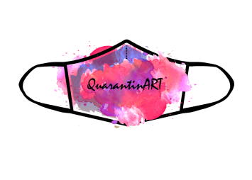

QuarantinART
Inspire adults to explore their artistic side
KA227-5C93146E
KA2 - Cooperation for innovation and exchange of good practice KA227 – Partnerships for the Creative World
Module: HANDCRAFT
Topic: 1,2,3,4
Developed from: Bratislava Policy Institute

Slide 2
INDEX
Objectives of the module
Knowledge
Skills
General description of the module
1.1 What are handcrafts?
1.2 Most typical types of handcrafts
1.3 References

Slide 3
OBJECTIVES OF THE MODULE
Increase the employment and opportunities of low skilled women through handcrafts
Boost the confidence of women in themselves through creating different handcraft
Show different techniques and inspire the women to create their own ones

Slide 4
KNOWLEDGE
Will learn the different types of handicrafts together with different techniques
Will be able to improvise with the materials which are available at home
Will be able to plan the creative process and set personal goals
Will be able to do evaluation of the product

Slide 5
SKILLS
Will be able to work with different techniques and materials
Will be able to use “scraps” from home
Will be able to make decisions based on their resources and skills
Will be able to evaluate if the product is suitable for further production

Slide 6
GENERAL DESCRIPTION OF THE MODULE
In this module there are new particular techniques explained in the area of arts and crafts. As there are many products which can be created through different techniques we took into the consideration the content of other modules, the possibilities to do these at home without spending unnecessary resources on materials and also the techniques which we see as quite simple to replicate and turn into a potential income.
Expected impact of the course in terms of developing the above training objectives.
Skills and methods learned through this module focus on offering women to create from the materials available at home, teaching them only basic techniques which they can develop either on their own or following some accessible courses either online or offline. As the techniques are quite simple and show only the basis for each technique it supports the women to be more creative on their own - solve the potential problems and also learn new digital/technological skills either creating the art and making it viral or to follow the artists in this area.

Slide 7
INTRODUCTION
WHAT ARE HANDCRAFTS?
Handicrafts/handcrafts are items that are constructed by hand using simple tools rather than mass production methods and equipment. While very similar to basic arts and crafts, there is one key difference with handicrafts. The items produced as a result of the efforts are designed for a specific function or use as well as being ornamental in nature. Handicrafts involve the creation of a wide range of objects, including clothing, religious symbols and jewelry, and different types of paper crafts.

Slide 8
MOST TYPICAL TYPES OF HANDCRAFTS
Two of the most common forms of handicrafts are knitting and crocheting. Both pastimes are capable of producing many different items that are both appealing to the eye and very practical. Knitting is a popular means of creating clothing such as sweaters, mittens, and stocking caps. Crocheting can be used to produce unique and visually appealing products for use in the home, such as pillow covers, table coverings, doilies, and afghan throws. Both methods allow for creating interesting color palettes and designs as well as going with simple color schemes for a more subdued look.

Slide 9
MOST TYPICAL TYPES OF HANDCRAFTS
Jewelry making is another example of handicrafts. The jewelry pieces created may use a combination of metal and various types of stones. However, paper crafts can also be used to create interesting designs for earrings, necklaces, ankle bracelets, or rings. Whatever the choice of materials, they are worked and shaped using simple hand tools, which give each piece a sense of being unique rather than uniform look.
Beading and embroidery are also fun pastimes that are classified as handicrafts. Beadwork can be used to enhance the look of any type of garment ranging from blouses and skirts to shawls and headcoverings. Sweaters sometimes feature beadwork as a means of adding a touch of elegance to the front or shoulders of the garment.

Slide 10
MOST TYPICAL TYPES OF HANDCRAFTS
Embroidery often serves the same basic function as beading, but utilizes different sizes and colors of thread to produce designs that are pleasing to the eye. Embroidery may be used to personalize throw pillow, jean pockets, sweater fronts, or even table coverings. As with all types of handicrafts, these two methods rely on the vision and dexterity of the individual to produce the desired result rather than some type of production machinery.
Sewing in general can be regarded as an example of handicrafts. Cutting and sewing a slipcover for a chair would meet this definition, as would creating pillow shams or using lengths of material to create drapery or curtain panels for window treatments. Even sewing a hem onto terrycloth sections that are cut to size and creating kitchen towels would be considered a handicraft activity.

Slide 11
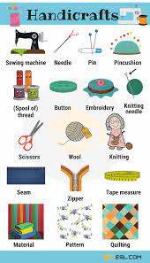
MOST TYPICAL TYPES OF HANDCRAFTS
Since the idea behind handicrafts is that any item produced must be useful as well as decorative, the implication is that they can also be cleaned with relative ease. For example, a tablecloth embroidered with holiday designs would normally be safe to wash by hand or in a standard washing machine.

Slide 12
REFERENCES
https://www.homequestionsanswered.com/what-are-handicrafts.html
https://7esl.com/handicraft-vocabulary/
https://diffsense.com/diff/handcrafted/handicraft
https://7esl.com/handicraft-vocabulary/

Slide 13
MATERIALS & TOOLS
Handicraft and woodworking utilize a wide range of tools and materials to create crafts, decorative objects, furniture and implements. Some crafts, such as beadwork, involve only small hand tools, while endeavors such as cabinetmaking often require an a shop full of power tools. The materials used for handicrafts are limited only by the imagination of the craftsperson.

Slide 14
HAND TOOLS
Hand tools are generally used for applications that require less power and greater finesse. In woodworking, operations such as finish planning and dovetail cutting are frequently done with hand planes and small hand saws. Handicrafts can involve the use of hand tools including needles, glass cutters, looms, spinners and presses. Hand tools allow the craftsperson to remain connected to the work without the excess power and noise of power tools. It is necessary to learn how to use hand tools properly and to maintain them so that they work at a high level of precision.

Slide 15
POWER TOOLS
Power tools can help the hobbiest avoid difficult drudgery, particularly in woodworking. Power jointers and planers take the rough surfaces off of lumber and flatten boards so they can be used to build precision furniture. Power saws remove the time and labor required to cut boards by hand. For best results, power tools must be maintained regularly, with their blades, knives and cutting edges kept razor sharp. Because they are so powerful, misuse of these tools can result in irreparable mistakes during a project, as well as potential safety hazards.

Slide 16
LUMBER
Woodworkers utilize many different kinds of wood. Kiln-dried hardwoods are purchased at lumber stores for cabinetmaking. When lumber is kiln-dried, its moisture content is reduced to around seven percent, ensuring that it will not warp, swell and shrink after it has been made into furniture. Some cabinetmakers, particularly chair builders, prefer to work with green wood. Traditional chair makers can build chairs of ash that has been cut from a recently downed tree. The green wood is typically easier to work with hand tools.

Slide 17
CRAFT MATERIALS
Handicrafts utilize a wide variety of materials. Sewers and knitters use thread, yarn and fabrics, and sometimes create these materials themselves with spinners and looms. Glassblowers use molten glass and kilns, while stained glass workers make creations out of hard sheets of colored glass. Many people engage in crafts with children, and use household objects such as scrap cloth, newspaper, glue and macaroni for creative art supplies.

Slide 18
OTHER TOOLS AND MATERIALS
Craft Knife. Some craft knifes have interchangable blades.
Glue Gun. Glue guns come in various sizes.
Woodburning Tool. Use a wood burning tool to make a sign.
Scissors. Use craft scissors to scallop the edges of paper.
Cutting Tools.
Miter Box.
Pliers.

Slide 19
OTHER TOOLS AND MATERIALS
Textiles. Appliqué, Crocheting, Embroidery, Felt-making, Knitting, Lace-making, Macramé, Quilting, Tapestry art, Weaving
Woodcraft
Papercraft
Pottery and Glass Crafts (see also Ancient Pottery)
Jewellery
Other Examples of Craftwork

Slide 20
BASIC ESSENTIALS
Hot Glue Gun.
Scissors/X acto Knife/ Pen Blade.
Cutting Mat.
Paint/paint brushes.
Fabric/thread/sewing machine.
Paper.
Electronic/Manual Cutting Machine.
Ribbon.

Slide 21
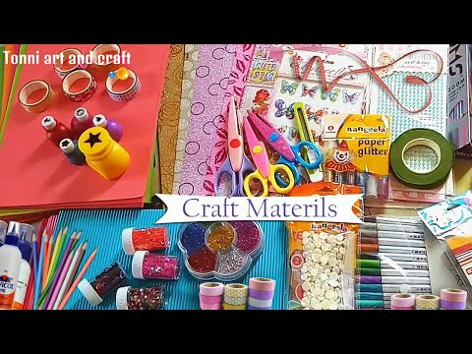

Slide 22
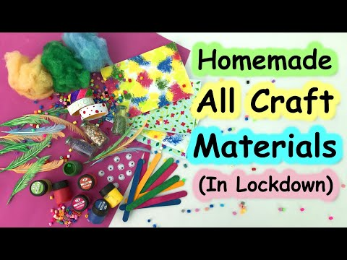
HOW TO MAKE MATERIALS AT HOME (LOCKDOWN TUTORIAL)

Slide 23
REFERENCES
https://ourpastimes.com/sudoku.html
https://diaridelsestudiants.com/what-are-the-raw-materials-used-in-handicrafts/
https://www.youtube.com/watch?v=xZ4UJAynHlI
https://www.youtube.com/watch?v=yw9yqrw44ms

Slide 24
EMBROIDERY – WHAT DO YOU NEED?
To start embroidering, you'll need the following items:
Embroidery hoop - this is a ring consisting of two parts. You put the fabric in between the hoops - this helps keep it taut, making the embroidering easier. These come in plastic and wood
Small, sharp scissors - You can find these under many names - though a google search for "embroidery scissors"
Embroidery floss -This is cheap and comes in lots of colors.
Embroidery needles - These have bigger eyes than normal needles to accommodate the size of the floss.
Water soluble marker or other marking tool. This way you can draw designs onto your fabric! It's best it you use a water soluble pen so you can rinse the markings out with cold water at the end.
Whatever fabric you like! Muslin, quilting cotton, canvas and linen all work well. I typically embroidery on a linen blend

Slide 25
EMBROIDERY – WHAT DO YOU NEED?
To start embroidering, you'll need the following items:
Embroidery hoop - this is a ring consisting of two parts. You put the fabric in between the hoops - this helps keep it taut, making the embroidering easier. These come in plastic and wood
Small, sharp scissors - You can find these under many names - though a google search for "embroidery scissors"
Embroidery floss -This is cheap and comes in lots of colors.
Embroidery needles - These have bigger eyes than normal needles to accommodate the size of the floss.
Water soluble marker or other marking tool. This way you can draw designs onto your fabric! It's best it you use a water soluble pen so you can rinse the markings out with cold water at the end.
Whatever fabric you like! Muslin, quilting cotton, canvas and linen all work well. I typically embroidery on a linen blend

Slide 26
HOW TO USE A HOOP
Cut a square of fabric slightly larger than your hoop.
To start, loosen the screw at the top of the hoop. You'll then separate the hoops. Place the outer hoop to the side. (If you're using a plastic hoop, the inside hoop will have a lip. This lip can come over the top of the hoop OR hang below the bottom). Lay the piece of fabric over the plain inside hoop.
After you have the fabric over the inside hoop, push the top hoop down over the inside one. This will sandwich the fabric between them. Now you'll want to tighten the screw a bit and begin pulling the fabric taut. The fabric floating between the hoops should not give very much - this will make the embroidering much more complicated than it should be.
After the fabric is taut, keep tightening the screw until it feels secure to you. But not so tightly you can't budge it! You'll regret that once you've embroidered for a couple hours and your sore fingers can't open the hoop. ;)

Slide 27
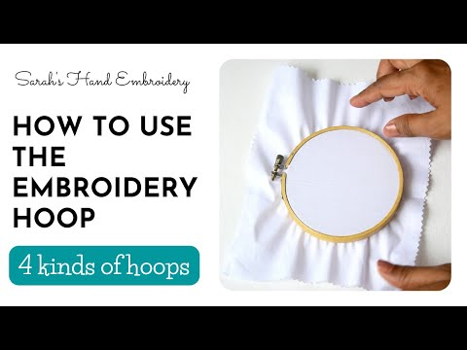
HOW TO USE A HOOP

Slide 28
THREADING THE NEEDLE AND ALL ABOUT THE FLOSS
Needle threading can be a little complicated at times. The easiest way to do it is to wet the very end of the floss (yes, put it in your mouth.) and squish it between your thumb and forefinger. This will flatten it out and allow it to pass through the eye of the needle with less fuss.
Also: keep in mind that you do not double the floss as you sometimes do with thread. You're simply going to pull the thread through the eye and let a few inches hang loose. You'll knot the other end as usual. (And make sure to cut off the loose stuff after the knot - it'll make your work neater! Never leave more than 1/2 inch behind the knot, or it'll get tangled while you stitch.)
Most floss is multi strand. The most common is six strands. You can divide the floss for more detailed work. The best way to do this it to use your fingernails to separate the strands and then pull is apart slowly.

Slide 29
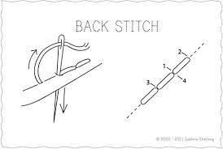
BACKSTITCH
Backstitch is so easy to learn that you'll have it down within the first few stitches. This basic stitch is likely to be the stitch you'll use the most. Backstitch is useful for any kind of outlining, but it's also a stitch that pairs well with other stitches, making it a key stitch to learn.
It's also easy to embellish with
weaving or wrapping, and quickly
transforms into the more decorative
Pekinese stitch.

Slide 30
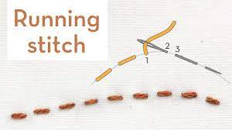
RUNNING STICH
Running stitch is a simple embroidery stitch that is good for making dashed outlines and adding details to your embroidery. It's also the basis for Japanese sashiko embroidery.
Although basic, it's adaptable and can become complex. For example, you can change the look by adjusting the length and spacing or adding a second row of stitches between the first. It's also another stitch that works well with weaving and wrapping.

Slide 31
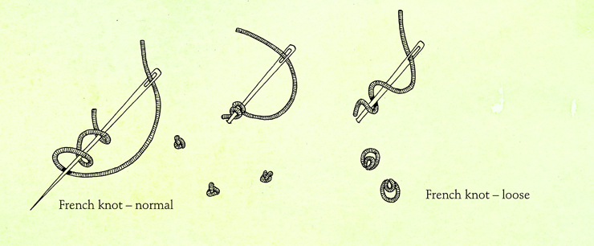
FRENCH KNOT
For many stitchers, making French knots remains a challenge. While it may take time to learn, it's worth the effort. Not only is this a common stitch to find in embroidery patterns, but it's also a good stitch to use when making a textured fill or other design elements.
This stitch involves wrapping
the needle to form a knot on
the surface of the fabric. The
trick to making French knots
is to hold the working thread
taut, but not too tight. Give it
some practice.

Slide 32
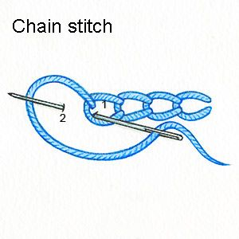
CHAIN STITCH
If you want a bolder line of embroidery, then chain stitch is the stitch for you. Chain stitch forms a row of linked stitches that really stands out.
There are several ways to work the chain stitch and it's a good idea to at least learn how to work it forward and in reverse. Once you have those mastered, try some of the other variations.

Slide 33
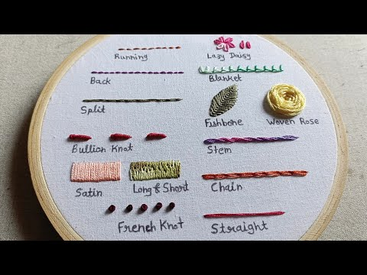

Slide 34
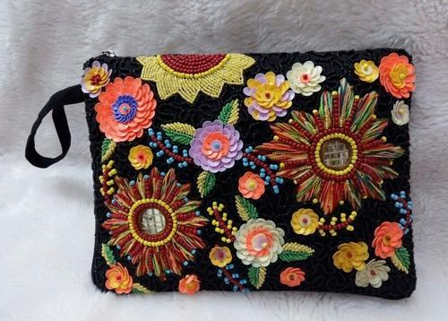
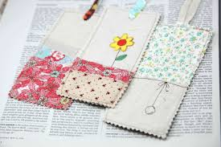
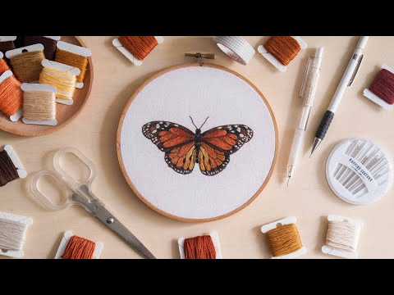
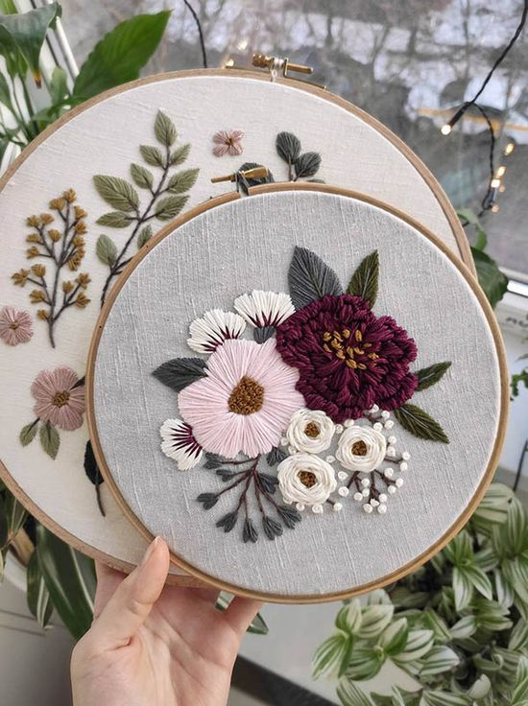
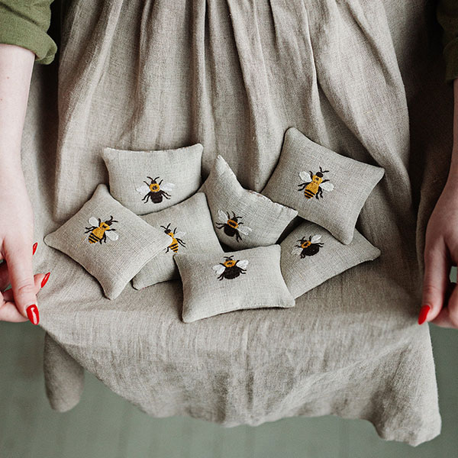
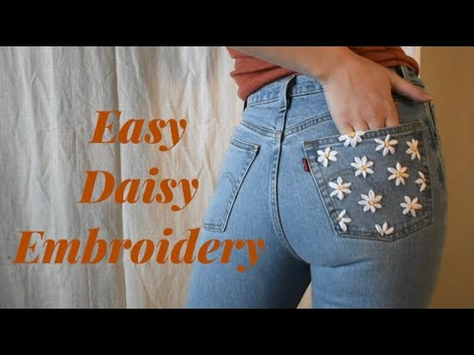
FINAL PRODUCTS

Slide 35
REFERENCES
https://www.youtube.com/watch?v=0VFXkL1Kr-A
https://www.instructables.com/Embroidery-101/
https://www.dicraft.com/blogs/blog/french-knot

Slide 36
KNITTING & CROCHET
Knitting involves the use of two long, straight needles to work a wool yarn into a nice, loose fabric. To do this, pick up each of the stitches with one knitting needle and knit them off again with the other needle. The individual loops intertwine to form a soft and elastic weave that is perfect to make garments out of. For example, you can create soft jumpers and cardigans in your favourite colour, warm hats and scarves for the winter, or cosy baby socks for the youngest in the family.
If you want to learn to knit, you should start with easy projects with a simple pattern and a clear shape, like a scarf or a small blanket. When choosing the right needles, beginners can opt for thicker wooden or bamboo needles. This will help you to knit more quickly, you will be able to grip the needles better and the stitches will not slip off the needle so easily.

Slide 37
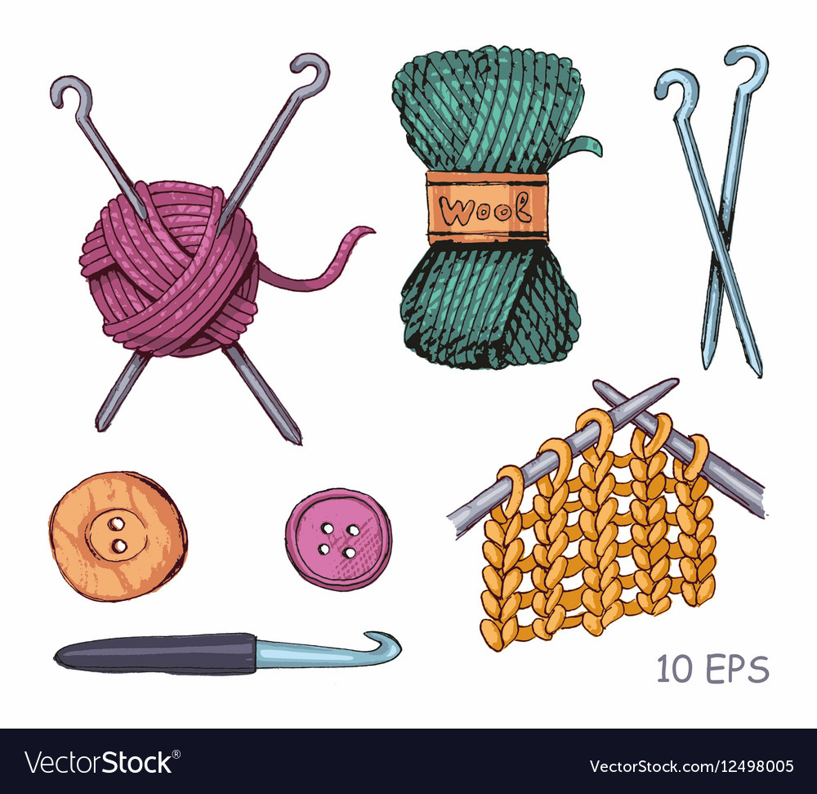
KNITTING & CROCHET
You don’t need many accessories to get started with knitting:
Knitting needles
Wool (to fit your needles, the information should be on the band around the ball)
A measuring tape
Scissors
Darning needles
Stitch markers if necessary

Slide 38
KNITTING & CROCHET
In contrast to knitting, you only need one needle for crochet. It’s long and has a little hook at the end so you can easily pick up the stitches and knot them. When you learn to crochet, you work stitch by stitch, until you have a strong fabric. Because you only have one stitch on your needle at a time, it is usually easier to learn crochet for beginners. However, the finished fabric is not as loose and elastic as a knitted one. The tight crochet stitches are great for decorative tablecloths, cosy blankets, stylish potholders, shopping nets, or even crocheted toys (also called amigurumi).
If you want to learn to crochet, start with a simple tutorial. A good starting point for beginners are things like potholders, a simple scarf, or a simple hat. If you want to try your hand at amigurumi, choose dolls that are as round and simple as possible. For example, round birds, snowmen, or simple teddy bears. The best way to learn to crochet is with a thick needle. It should be between 3.5 and 4.5 mm wide and made of metal, as these needles won’t break so quickly.

Slide 39
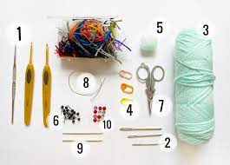
KNITTING & CROCHET
To be able to start crocheting right away, you need this small basic equipment:
A crochet hook
Wool (to fit your needles, the information should be on the band around the ball)
A measuring tape
Scissors
Darning needles
Stitch markers (if necessary)
For amigurumi additionally: cotton wool & safety eyes

Slide 40
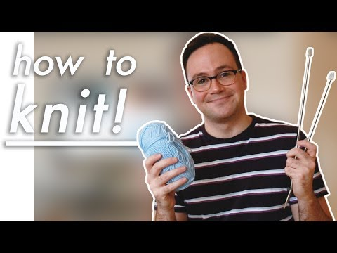

Slide 41
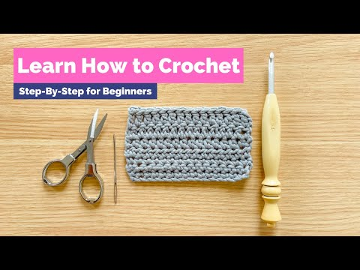

Slide 42
REFERENCES
https://www.c-and-a.com/eu/en/shop/handicrafts#R2
https://www.thesprucecrafts.com/stitches-every-embroiderer-should-know-4122123
https://www.youtube.com/watch?v=zzWX2dx8ufc
https://www.youtube.com/watch?v=uqQWpTOx22c
https://www.youtube.com/watch?v=p_R1UDsNOMk
https://www.youtube.com/watch?v=DsmdM51Gfws

Slide 43
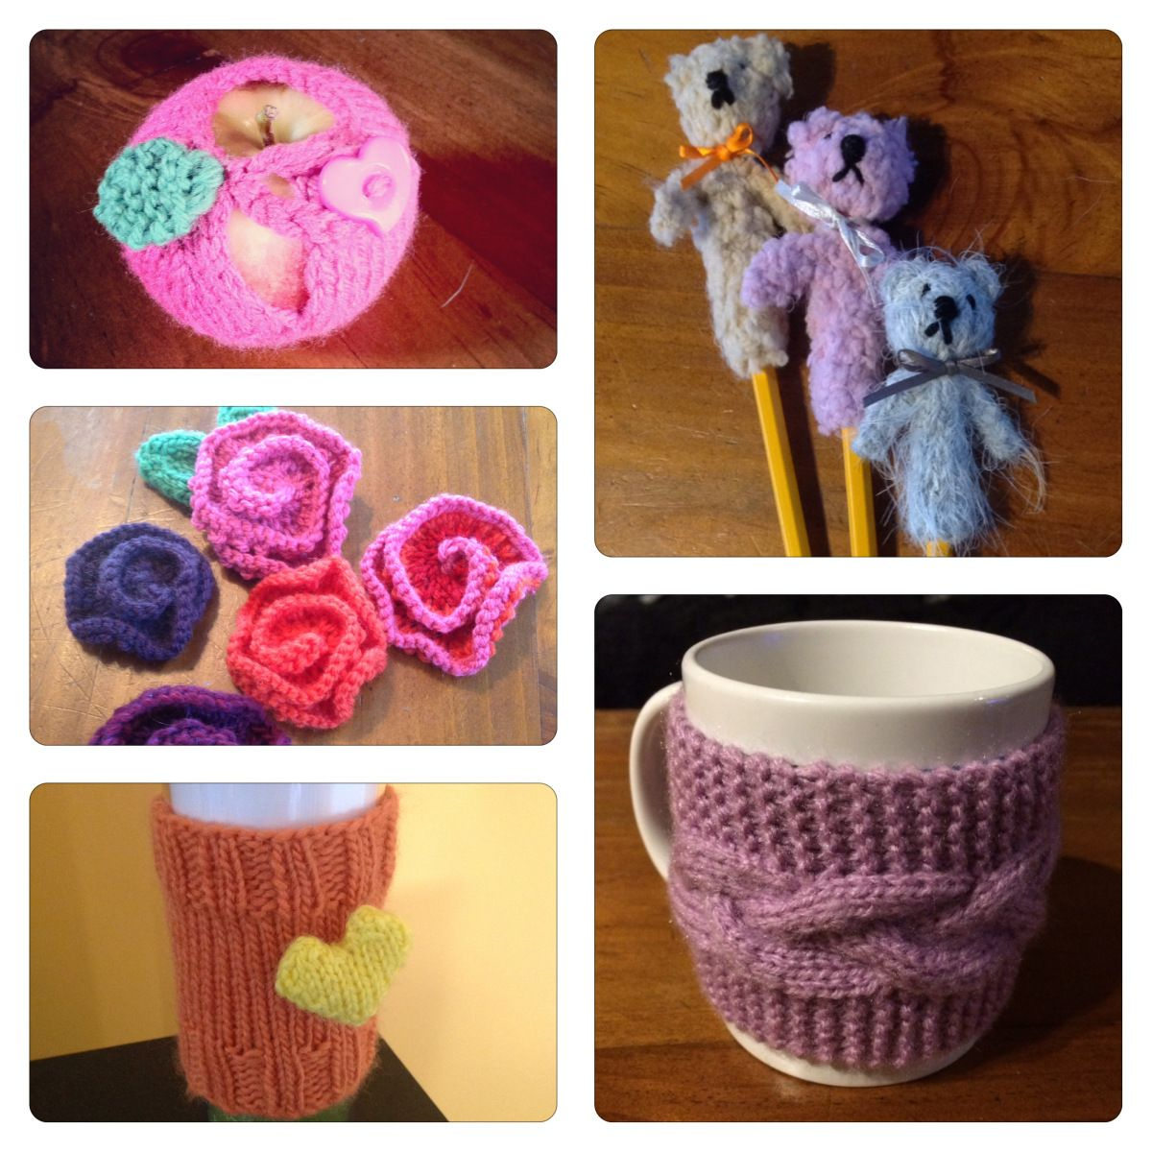
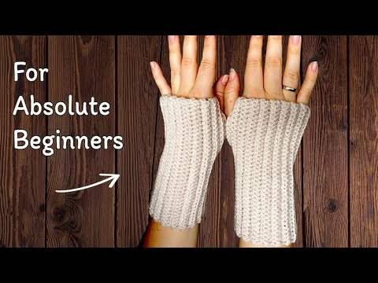
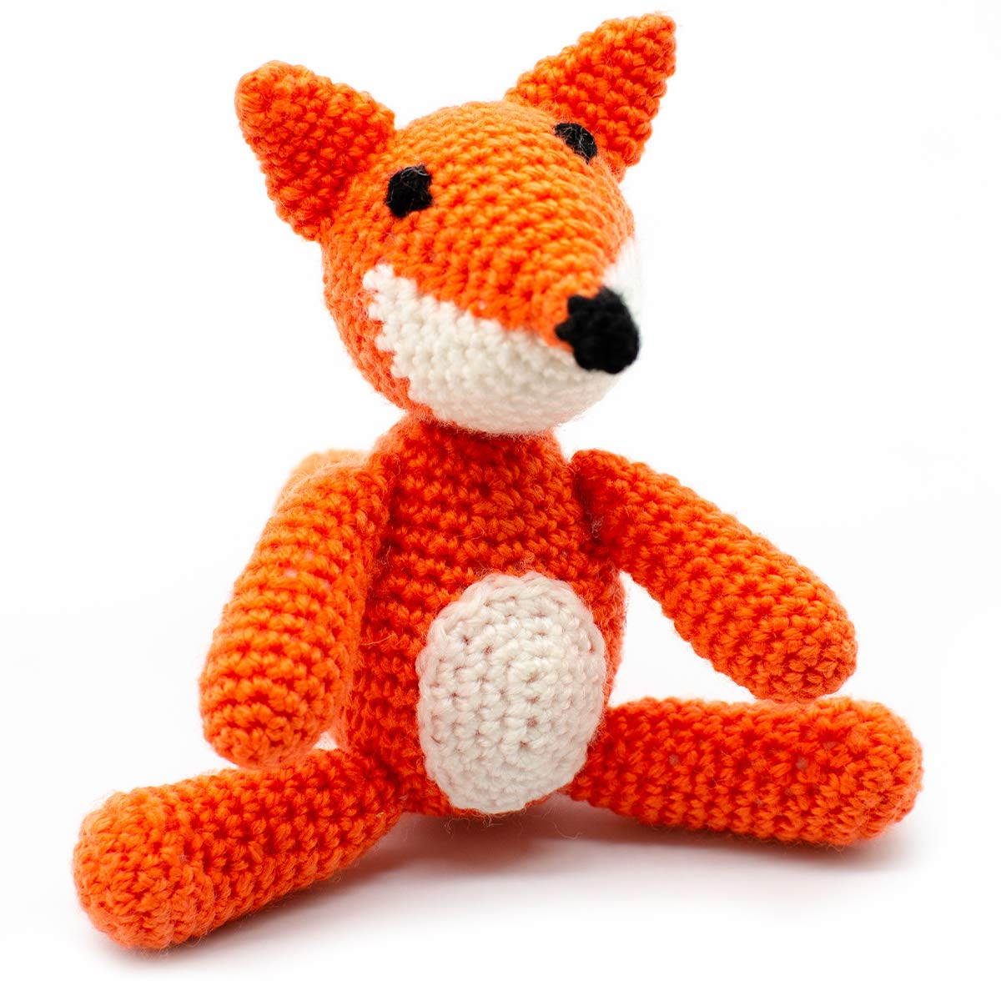
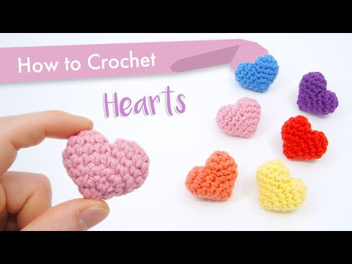
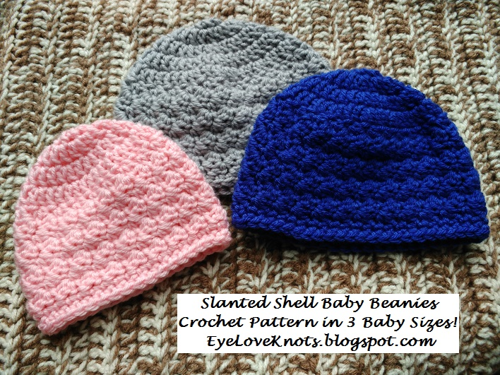
FINAL PRODUCTS

Slide 44
DO DO
Crafters do not make mistakes....They just add a new "design element"

